Slide 1
Colloquium with Ambassador Maurizio Massari -- Permanent Representative of Italy to the United Nations
GW Law School – Stuart 101
Thursday, February 9, 2023
11-12

Slide 2
Agenda
Introductions
Dialogue – Professor Benedetta Audia & Ambassador Massari
Next Steps in the UNCITRAL model law on public procurement – Professor Yukins

Slide 4
Questions for Ambassador Massari – Professor Benedetta Audia

Slide 5
UNCITRAL Model Procurement Law: Potential Next Steps
Christopher Yukins
George Washington University Law School
Special thanks to: Caroline Nicholas UNCITRAL Secretariat

Slide 6
The UNCITRAL Model Law – 1994-2011
Non-binding “private international law” template for a national procurement law, with options
Influence (1): Main users: economies in transition/developing countries
Influence (2): Main contributors to negotiations: developed countries, IGOs
Geo-economic background: anti-corruption to financial crisis
2011 text is more complex than 1994 iteration, reflecting procurement market
3
Notes:
6

Slide 7
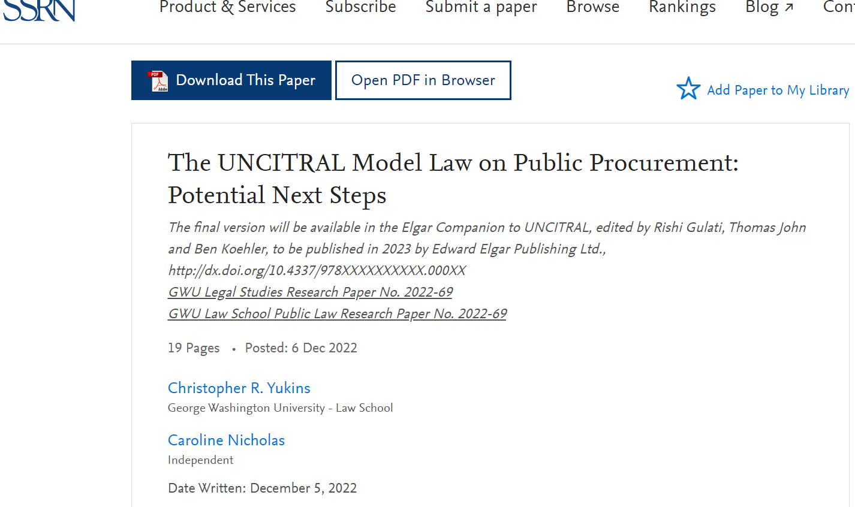

Slide 8
Contextualising this “international” legal text on Public Procurement
Notion of legal harmonisation à la UNCITRAL and its application in the procurement context
Reforming UNCITRAL texts in general and 2011 Model Law on Public Procurement in particular
Main areas of debate and reform
Success factors in developing an UNCITRAL text & in procurement
Potential next steps
2

Slide 9
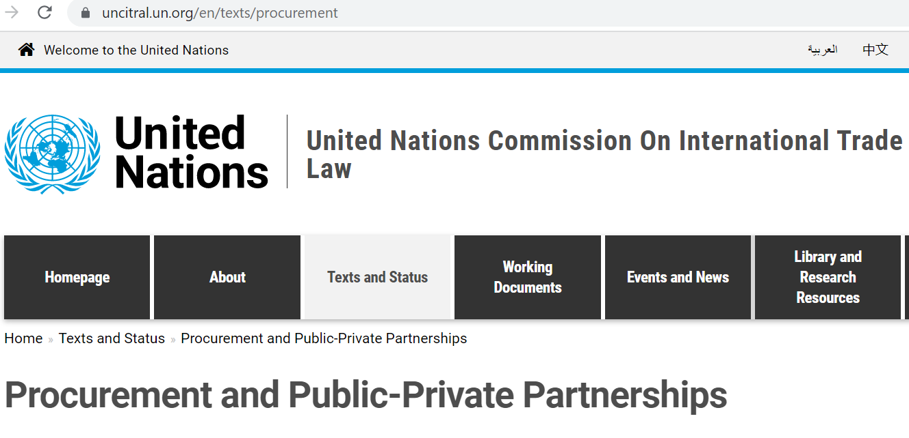
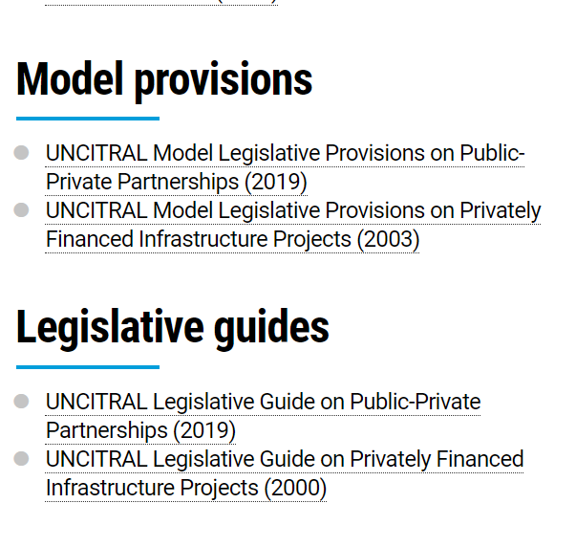
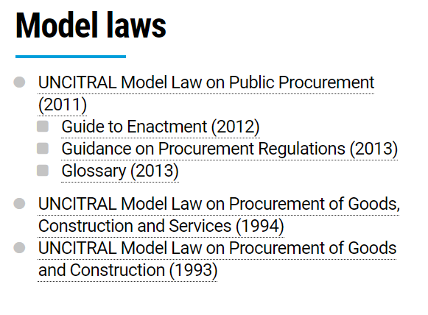
uncitral.un.org/en/texts/procurement
4
Notes:
9

Slide 10
Key issues of debate during the reforms
Transparency and discretion
E-procurement as a tool
Harmonisation:
Accommodating different maturity in systems
Accommodating changing country priorities
Introducing modern procurement methods – Value-Based Procurement
Bid Challenges
Anti-Corruption & Compliance
6

Slide 11
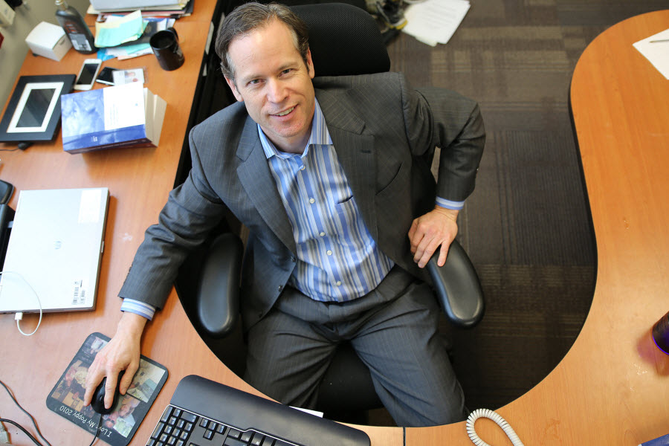
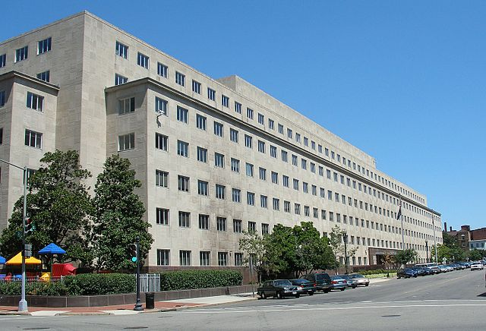
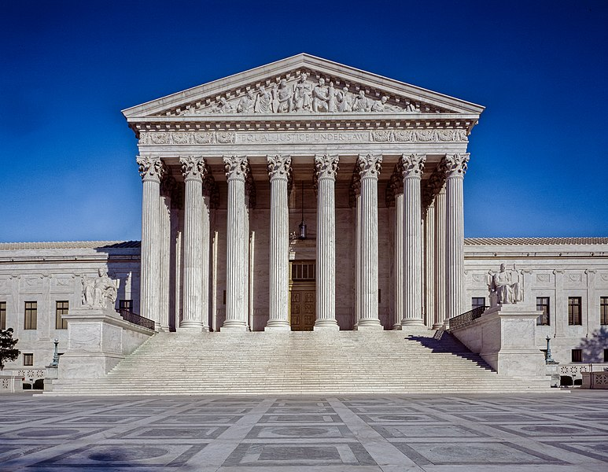
UNCITRAL Bid Challenge Forums
Procuring Agency
Independent Agency
Court

Slide 12
UNCITRAL: Possible Appeals for Bid Challenges
Procuring Agency
Independent Agency
Court
Court
Independent Agency
Court

Slide 13
Success factors
Within the UNCITRAL process
Experience-based reforms
Broad participation
Consensus building
Beyond the UNCITRAL process
Transparency
Intellectual leadership from academic and policy leaders
These factors played out in the use of UNCITRAL texts
7

Slide 14
UNCITRAL Model Law: Potential Next Steps

Slide 15
Potential Reforms to UNCITRAL Model Law
Environmental Sustainability
Contract Administration
Exclusion and Debarment
Open Contracting

Slide 16
Strategies for Environmental Sustainability
Planning
Contractor
Qualification
Eco-Label
Technical Evaluation
Life-Cycle Price

Slide 17
Contract Administration
Clauses
Contracts
Courts

Slide 18
Exclusion & Debarment

Slide 19
U.S. vs. UNCITRAL
United States | UNCITRAL
Adequate financial resources | Adequate financial resources; not insolvent
Technical qualifications | Technical qualifications
Integrity and business ethics | Integrity and business ethics
Capable of performing | Capable of performing
Necessary facilities | Necessary facilities
Satisfactory performance record | “Capability, reliability and experience”
Paid federal taxes | Paid taxes
Contractor and principals not convicted or debarred | Contractor and principals not convicted or debarred
Notes:
United States
FAR 9.401-1
UNCITRAL
Art. 9

Slide 20
Four Paradigms
Responsibility (Qualification)
Only
On a case-by-case basis
Adjudicative Debarment for “Bad Acts”
E.g., World Bank
Discretionary Debarment – U.S. Federal
In U.S. – done by contracting officer
Debarment is a cross-government “meta-qualification” determination
Based on “present responsibility”: focus on present status
Court-Ordered Debarment, After Judicial Proceedings
Allowed by new EU Directives
Performance Risk
Reputation Risk

Slide 21
Cross-Debarment
Options:
Automatic cross-debarment
Debarment (list) to be considered in other systems
Debarment + adverse info to be considered
Do nothing

Slide 22
Using Debarment Information Across Borders
Other Governments
Who was debarred (list)
Why was that person debarred = Qualification information
How was the debarment done – is the process reliable?

Slide 23
Open Contracting – Data Must Be . . .
Accessible
Machine Readable

Slide 24
Conclusion

