Slide 2
Welcome Professor Christopher Yukins GW Law School
Recording and materials at www.publicprocurementinternational.com
Questions & Answers (Q&A)
All speakers’ statements are in their personal capacities

Slide 3
Agenda
Introductions
Christopher Yukins, GW Law School
Understanding the FSR’s impact on procurement
Pascal Friton, Max Klasse & Ramona Ader, Blomstein (Berlin)
Discussants:
Jean Heilman Grier – issues in transatlantic trade
Robert Anderson – FSR and WTO agreements (GPA and Subsidies Agreement)
Christian Filippitsch, Reed Smith (Brussels): Preparing for the FSR

Slide 4
Panelists and Discussants

Slide 5
A new barrier to transatlantic procurement: The European Union’s Foreign Subsidies Regulation
Dr. Pascal Friton, LL.M.
Dr. Max Klasse
Ramona Ader
18 April 2023

Slide 6
Background
Low level of international harmonization re subsidies
+
Increasing level of subsidies
(Perceived) strict State aid law regime in the EU
Fear of EU companies being disadvantaged in competition with companies from countries that are subject to less restrictive state aid control
Notes:
Harmonization only under the WTO Agreement on Subsidies and Countervailing Measures (ASCM) and bilateral agreements between states
Effects of ASCM remain modest:
Scope is limited to goods, while a major part of economic activity in the industrialized countries now falls within services sector
Lack of incentives for the actual notification of subsidies by states
Subsidies granted by state-owned enterprises have not been covered far enough
Increasing level of subsidies: Specifically, after the end of the Cold War, countries with state-controlled economies (particularly from the Middle East and Southeast Asia, above all China) became more and more entangled in international trade
(Perceived) strict State aid law regime in the EU: Art. 107-109 TFEU prohibit EU Member States from granting support to companies or economic areas through State aid. State aid is allowed only if certain conditions are fulfilled and if that aid has been approved by the European Commission prior to its granting. The underlying rationale is that too much freedom for the individual Member States in State aid policy is not compatible with the basic idea of the EU single market, as it could result in competition in the internal market being distorted, especially in favor of companies from Member States with deeper pockets, such as Germany and France.
EU State aid law applies only to subsidies granted by EU Member States and not to subsidies from third countries (such as benefits under the U.S.’ Inflation Reduction Act). The EU State aid law regime thus creates a level playing field between companies located in the EU, but not vis-à-vis companies from third countries.

Slide 7
The three tools of the FSR
General tool to investigate all other market situations
(ex-officio)
Notification based tool to investigate bids in public procurements
Notification based tool to investigate concentrations
Notes:
Creation of the FSR which entered into force on 12 January 2023
With respect to the two notification based tools, the parties will have to notify ex-ante financial contributions received from non-EU public authorities prior to concluding a concentration or a public procurement procedure above the relevant thresholds. Applicable from 12 October 2023.
The general investigation tool would allow COM to start investigations on its own initiative (ex-officio). This would cover other types of market situations, such as greenfield investments or concentrations and public procurements below thresholds. Applicable from 12 July 2023.
In the following, we will focus on the notification tool in public procurement procedures, but we will also provide an overview on the ex officio and concentrations tool

Slide 8
Common Practice, that a third country grants certain undertakings subsidies
Notification based tool to investigate bids in public procurements

Slide 9
Notification obligation
Application of Procurement Directives (except for Defence Procurement Directive)
Value of public procurement/framework agreement ≥ EUR 250m
Aggregate “financial contribution” ≥ EUR 4m in the last 3 years per third-country
➔Threshold applies to all contributions to the whole group of the bidder as well as main subcontractors and suppliers
Notes:
Applicable to procurement procedures according to Dir. 2014/24/EU, 2014/25/EU, 2014/23/EU (not: Dir. 2009/81/EC)
Acc. to Art. 2 (4), contracting authority/entity is defined in accordance with the beforementioned Procurement Directives, i.e. no application to EU institutions
Certain exclusions apply, e.g. where the negotiated procedure without prior publication is permissble due to reasons of extreme urgency brought about by events unforeseeable by the contracting authority (Article 32(2)(c) Dir. 2014/24/EU)
Threshold: Where procurement is divided into lots, a notification obligation exists where the estimated value exceeds the threshold of ≥ EUR 250m and the value of the lot or the aggregate value of all the lots to which the tenderer applies is equal to or greater than EUR 125m. Between 2015 and 2021, reportedly only 936 procurement procedures were carried out in the EU with an estimated contract value of EUR 250 million or more. This comparatively low number reflects the Commission’s goal to use the threshold as a filter to single out procurement procedures that may have a significant impact on the level playing field for EU companies.
The EUR 4m threshold applies to the economic operator, including its subsidiary companies without commercial autonomy, its holding companies, and, where applicable, its main subcontractors and suppliers involved in the same tender in the public procurement procedure . A subcontractor or supplier shall be deemed to be main where their participation ensures key elements of the contract performance and in any case where the economic share of their contribution exceeds 20% of the value of the tender. The first criterion (participation which “ensures key elements” of performance) is particularly vague and is expected to result in considerable uncertainty as to which subcontractors/suppliers must be taken into account.
The contracting authority shall state notification obligation in the contract notice or, in case a procedure without a prior publication is conducted, in the procurement documents. However, the absence of such a statement is without prejudice to the application of FSR.
In an open procedure, the notification or declaration shall be submitted only once, together with the tender. In a procedure consisting of multiple stages, the notification or declaration shall be submitted twice, first with the request to participate and then as an updated notification/declaration with the submitted tender or final tender.

Slide 10
Financial contribution
A “financial contribution” is defined widely to include
Notification obligation is not limited to subsidies: Financial contribution is only one element of foreign subsidies definition
Does not require a market advantage
(a) transfer of funds or liabilities (e.g. capital injections, grants, loans, guarantees, fiscal incentives, debt forgiveness, debt to equity swaps, rescheduling);
(b) foregoing of revenue that is otherwise due (e.g. tax exemptions, granting of exclusive rights without adequate remuneration); or
(c) provision or purchase of goods or services
Do even government contracts awarded in competitive procurement procedures qualify as a financial contribution?
Notes:
Definition of financial contribution, Art. 3 (2) FSR, is very broad
In the definition of a foreign subsidy in Art. 3 (1) FSR, limitation to measures that confer a market advantage is made by the additional criterion “a financial contribution which confers a benefit on an undertaking”
Potential background of choosing the “financial contribution” (and not “foreign subsidy”) to trigger the notification obligation: Especially in case of injection of capital into state-owned enterprises it may be difficult to determine whether this confers a market advantage (e.g. injection of capital by China into a viable SOE). The COM might have wanted to assess themselves whether such capital injection is on market terms or qualifies as a subsidy.
However, such broad understanding could mean that even government contracts awarded in competitive procurement procedures qualify as a financial contribution, which would lead to a very broad scope of the notification obligation
It is to be hoped that there will be further guidance on that
Until there is further guidance, we recommend to apply a broad understanding to prevent exclusion from public procurement procedures or even fines, which is the result in case of an incomplete notification

Slide 11
Declaration obligation
“In all other cases“:
Obligation to declare all foreign financial contributions and confirm that they are not notifiable
Not applicable to:
Procurements not covered by Procurement Directives
Procurements under Defense Procurement Directive
Applicable to:
Procurement with value of ≥ EUR 250m
+
aggregate “financial contribution” < EUR 4m in the last 3 years per third-country
Application unclear:
Procurement with value of < EUR 250m
Notes:
Declaration obligation is very broad: Acc. to Art. 29 (1) FSR, it applies “in all other cases” (compared to notification obligation: “Where the conditions for the notification of financial contributions in accordance with Article 28(1) and (2) are met”)
It is to be hoped that further clarification will be provided before the notification and declaration obligations enter into force in October 2023
Additional possibility to request notification, Art. 29 (8) FSR :
European Commission suspects that a company may have benefitted from foreign subsidies in the last 3 years (e.g. because of a declaration)
Possibility of European Commission to request notification of foreign financial contributions that are not notifiable before award of the contract
Provisions for notifiable foreign financial contributions apply

Slide 12
Information required for notifications and declarations
Notifications
- Description of public procurement procedure
- Information about the party(ies)
- Detailed list on foreign financial contributions
- Explanations on positive effects of the subsidy
- Supporting documentation
- Explanation to justify that the tender is not unduly advantageous
- Attestation of correctness and completeness
Declarations
- Description of public procurement procedure
- Information about the party(ies)
- List of all foreign financial contributions
- Attestation of correctness and completeness
Obligations in effect from 12 October 2023
Notes:
Commission published draft implementing regulation at the beginning of February 2023
With the draft Implementing Regulation now submitted, the Commission provides more detailed information on how relevant notifications and declarations are to be made. The requirements are detailed in two annexes, one for concentrations and one for public procurement procedures. The annexes also include standardised forms that should be used.
Furthermore, the draft regulation provides rules for the investigation by the Commission, in particular the timelines, the conduct of interviews and oral statements as well as the submission of commitments. The draft also includes the details of disclosure and rights of defence of the company under investigation.
This chart shows the information required in the notification/declaration according to Draft Implementing Regulation
Notification and declaration obligations under the FSR for parties of a concentration as well as bidders in public procurement procures will start to apply on 12 October 2023.
Missing notifications or declarations could be made up for within 10 working days upon request by the contracting authority or the Commission. If the failure is not corrected in due time, the tender can be excluded (Art. 29(3)–(4))
As it can be seen, the requirements are quite high, so firms that regularly participate in public procurement procedures in the EU should make sure in advance that they have all the information ready at good time.

Slide 13
Two-stage review procedure
Preliminary review
In-depth investigation
Existence of a foreign subsidy?
Distortion in the internal market?
Balancing test
Sufficient commitments?

Slide 14
Existence of foreign subsidy
Art. 3 FSR
“For the purpose of this Regulation, a foreign subsidy shall be deemed to exist where a third country provides, directly or indirectly, a financial contribution which confers a benefit on an undertaking engaging in an economic activity in the internal market and which is limited, in law or in fact, to one or more undertakings or industries.”
Financial Contribution
Provided by a Third Country
Conferring a Benefit
Selectivity
Notes:
General remarks:
Wording differs from notion of State Aid according to Art. 107 (1) TFEU
Consequences resulting from different wording unclear: Broad discretion of
European Commission
While explanations in recitals of FSR closely resemble case law/Commission’s practice on notion of State aid (incl. Commission’s notice on the notion of State aid) , no specific reference is made in this regard in the Articles of the FSR
However, rec. 9 states that FSR should be applied and interpreted in light of the relevant Union legislation, including that relating to State aid, mergers and public procurement.
Therefore, remains to be seen whether existing case law/practice re Art. 107 (1) TFEU is transferable to FSR without any modification
Considering the objective of the FSR to create a level playing field regarding state subsidies for companies from the EU and third countries, a synchronization of definitions seems possible
This could be welcome as firms, which are in any case burdened by the FSR, would at least be given some legal certainty
Criterion of benefit is likely to be most important
Explanations in reasoning re benefit is comparable Market Economy Operator Principle under EU State aid law
Benefit:
No definition in FSR
According to reasoning of FSR, a financial contribution should be considered to confer a benefit if it “could not have been obtained under normal market conditions”
Assessment on the basis of comparative benchmarks, such as
the investment practice of private investors,
financing rates obtainable on the market
a comparable tax treatment, or
the adequate remuneration for a given good or service
Purchase of goods or services following a competitive, transparent and non-discriminatory tender procedure is presumed to be in line with normal market conditions
State origin: „Provided by a third country“ includes
the central government and public authorities at all other levels;
a foreign public entity whose actions can be attributed to the third country, taking into account elements such as the characteristics of the entity and the legal and economic environment prevailing in the State in which the entity operates, including the government’s role in the economy; or
a private entity whose actions can be attributed to the third country, taking into account all relevant circumstances.
Means: Foreign subsidies are not limited to benefits provided directly by the state, but can be channeled through intermediaries (e.g. development banks, SOE)
Undertaking engaging in an economic activity: This excludes benefits for non-economic activities from the scope a foreign subsidy, i.e. activities that do not include offering goods and services on a market (such as exercise of public powers, e.g. army or police); likely to have no relevance with regard to FSR
Selectivity: A benefit is “limited, in law or in fact, to one or more undertakings or industries” if it is granted selectively to certain company, groups of companies or sectors
Government support programs are generally selective as they only apply to certain groups of companies, e.g. support to energy-intensive companies for decarbonization
Whether a benefit is selective can particularly be difficult in case of tax reliefs or exemptions (there is no clear case law even under EU State aid law)

Slide 15
Assessment of distortion
Most likely to distort internal market
Case-by-case assessment
Distortion unlikely
Subsidy granted to an ailing undertaking
Subsidy in the form of an unlimited guarantee for debts or liabilities
Export financing measure not in line with OECD Arrangement on officially supported export credits
Subsidy directly facilitating a concentration
Subsidy enabling an undertaking to submit an unduly advantageous tender
Distortion exists where a foreign subsidy is
liable to improve the competitive position in the internal market and
actually or potentially negatively affects competition in the internal market
Significant uncertainty for majority of cases
Total amount of the subsidy ≤ EUR 4m in the last 3 years
No distortion
Total amount of the subsidy ≤ EUR 200 000 in the last 3 years
Subsidy aimed at making good damage caused by natural disasters or exceptional occurrences
Notes:
Commission will consider certain indicators, such as
Amount of subsidy
Nature of subsidy
Purpose and conditions of subsidy
Situation of the company (e.g. size, market)
Level and evolution of economic activity of the company
Categories of foreign subsidies most likely to distort the internal market, Art. 5 (1) FSR: An undertaking under investigation shall be granted the possibility to provide relevant information as to whether a foreign subsidy falling under one of the categories set out above does not distort the internal market in the specific circumstances of the case.
Exceptional occurrences: e.g. damage compensation to airlines affected by COVID19 travel bans

Slide 16
Balancing test
Balancing test: Commission may balance
Broad discretion
negative effects of a foreign subsidy in terms of distortion
Benchmark: EU State aid case practice
Influence of softening of EU State aid regime?
positive effects on the development of the relevant subsidized economic activity on the internal market
Notes:
As a second step, the Commission, where warranted, considers the market-distorting effects of foreign subsidies and balances these against potential wider benefits (so-called balancing test).
Positive effects shall also include broader positive effects related to relevant EU policy objectives.
Relaxation of the (previously) strict EU State aid law regime in the last years and months: First due to the effects of the COVID 19 pandemic on the economy; since March 2022 to counteract the negative effects of the war in Ukraine and the rising prices for energy and recently from March 2023 to facilitate the green transition
The facilitation of State aid in March 2023 is seen as the EU’s response to the US Inflation Reduction Act: Therefore, it remains to be seen how the Commission will apply the FSR on subsidies under the Inflations Reduction Act
European Commission will provide
clarifications until January 2024 and
Guidelines on the application of the FSR until January 2026

Slide 17
Decision by the European Commission
Decision
No objection decision
Decision with commitments
Decision prohibiting the award of the contract
Decision is binding for the contracting authority
Award of contract to bidder under investigation is not allowed during Commission‘s assessment
Notes:
After assessing in two-step-procedure whether a foreign subsidy exists and whether it distorts the internal market, the European Commission makes ist decision
No objection decision: Commission finds that there is either no foreign subsidy or no distortion
The bidder can offer commitments to remedy the distortion: Commitments may include, inter alia, repayment of the foreign subsidy
Where the Commission deems the commitments appropriate and sufficient to fully and effectively remedy the distortion, it may adopt a decision in order to make those commitments binding on the undertaking (‘decision with commitments’)
If the Commission finds that a foreign subsidy exists which distorts the internal market and the bidder does not offer any or sufficient commitments, it adopts a decision prohibiting the award of the contract
Contract may also be awarded to the bidder under investigation if the time limits elapsed

Slide 18
General investigation tool (ex-officio)

Slide 19
General investigation tool: Application in public procurement procedures
Applicable to all Procurement Directives
(also defence and security contracts under Dir. 2009/81/EC)
Commission may on its own initiative examine alleged foreign subsidies distorting the internal market
Procedure generally corresponds to procedure after notification
But:
ex officio reviews are limited to awarded contracts and no cancellation of award decision or termination of a contract
Instead:
Commission may adopt a decision with redressive measures
(e.g. repayment of subsidy)
Notes:
Particularly relevant in case of defense and security contracts under Dir. 2009/81/EC where notification and declaration obligations do not apply (Art. 28 (3) FSR).
Recital 41 FSR: The balance between the development of a European defence and security equipment market, which is essential for maintaining a European Defence Technological and Industrial Base, and the protection of the national security of the Member States requires a specific regime for defence and security contracts covered by Directive 2009/81/EC. Public procurement for the award of such contracts should therefore not be subject to notification requirements under the FSR (see also Art. 28 (3) FSR). Nonetheless, it should be possible to examine the foreign subsidies in the context of such contracts in an ex officio review. Furthermore, public procurement covered by Directive 2009/81/EC and exempted by that Directive or to which the conditions for the application of Article 346 TFEU are fulfilled should not be covered by the FSR.
Use of general ex officio tool does not have any direct impact on public procurement procedures (Art. 9 (2))
However, COM can impose redressive measures (Art. 11 (2))
Article 7(4) FSR provides a non-exhaustive catalogue of examples for possible redressive measures, which also applies to commitments. However, most of these measures are tailored to distortive subsidies related to mergers (e.g., granting access to infrastructure). In the end, repayment of the subsidy in question may be the only enumerated measure that could reasonably also be applied to procurement procedures. Apart from the measures set out in the catalogue, the Commission is free to determine other remedies it considers suitable regarding public procurement procedures.
Ex officio investigations can be initiated for a period of 10 years after the granting of the subsidy, Art. 38(1). This long limitations period could lead to considerable legal uncertainty for companies benefitting from foreign subsidies. While it is to be expected that the ex officio tool will be applied only in extreme cases, theoretically companies that have received foreign financial contributions—even below the relevant thresholds—could be subject to a decision of the Commission ordering the repayment of the subsidy up to 10 years after a foreign subsidy has been granted.

Slide 20
Common Practice, that a third country grants certain undertakings subsidies
Notification based tool to investigate concentrations

Slide 21
Notification based tool to investigate concentrations
Turnover threshold: acquired company, one of merging parties or JV generates an EU turnover of ≥ EUR 500m
Mandatory notifcation requirement
Stand-still obligation (gun-jumping)
Financial contribution threshold: foreign financial contribution of ≥ EUR 50m in three previous years
Ad hoc notification request: Commission may request notification at any time prior to implementation of a concentration if it suspects that undertakings concerned have received foreign subsidies in three previous years
Notes:
Mergers were chosen as one of the two areas where the ex ante tool is used because although the EU possesses trade defense instruments for goods to counter third-country subsidized imports, financial flows and investments supported by subsidies have so far fallen through the cracks
This tool is relevant to firms from abroad that may merge (or otherwise integrate) with firms in the EU—an increasingly common occurrence in a globalized procurement market
Thresholds:
Concentrations trigger a notification obligation if two thresholds are met:
• The aggregate turnover of at least one of the merging undertakings, the acquired undertaking or the joint venture established in the EU, exceeds EUR 500 m in the EU, and
• All undertakings involved in the concentration were granted combined aggregate foreign financial contributions of more than EUR 50 m in the three financial years preceding the conclusion of the agreement, the announcement of the public bid, or the acquisition of a controlling interest
The term “undertaking” refers to the wider group of companies, i.e., it is not only the subsidiary involved in the transaction that is relevant.
The Commission has estimated that approximately “only” 40 to 50 transactions per annum exceed the turnover threshold, and that only a small part of these will also involve the amount of subsidies to trigger the notification obligation under the FSR. However, as was explained above, the broad notion of foreign financial contribution may make it difficult to sort out, with a sufficient degree of legal certainty, cases where the foreign financial contribution does not exceed EUR 50 million.
Procedure:
If a notification obligation applies, the review and investigation procedure is subject to comparable rules as in the context of public procurement procedures. There is no obligation to submit a declaration in cases that do not reach the threshold values.
Timing:
Pre-notification: Companies subject to notification obligations are invited to engage in pre-notification discussions with the Commission. The pre-notification phase serves to discuss, among other things, the precise amount of information required in the notification. According to the draft, pre-notification may result in a significant reduction of the amount of information to be submitted to the Commission as companies can ask for waivers to submit certain information required by the notification form. The Commission intends to consider such waiver requests if the relevant information is not reasonably available or not necessary for the examination of the case. The concept of pre-notification, which is also an established step in EU merger control and State aid procedures, can thus be used to significantly limit the administrative burden and ideally shorten the overall duration of the investigation procedure before the Commission.
While the review periods provided for in the FSR follow the timelines under the EU Merger Regulation (EUMR), the review procedures under the FSR and EUMR will be completely independent. If the Commission finds that a foreign subsidy distorts the internal market, it can request the parties to remedy the distortion by imposing redressive measures or accepting commitments offered by the respective undertaking(s). Such measures may consist, inter alia, of offering access under fair, reasonable, and non-discriminatory conditions to an infrastructure acquired or supported by the subsidy, reducing capacity or market presence, refraining from certain investments or requiring the companies concerned to adapt their governance structure. The Commission may prohibit the concentration where it finds that the foreign subsidy distorts the internal market and the positive effects do not outweigh the negative effects, taking into account redressive measures or commitments.
Standstill obligation:

Slide 22
Concentrations: Deal Planning
Keep in mind: When negotiating SPA…
Conditions precedent
Covenants for Purchaser filing obligations (e.g., regarding information sharing, document gathering, pre-notification, timing, redressive measures)
Seller to provide information and documents on Target and bidding process
High uncertainty regarding deal timing → Long-stop date / Remedies
Notes:
Consider including covenants for filing obligations for the purchaser (e.g. assist in the information gathering and pre-notification process to ensure timely compliance with applicable laws and regulations).
Consider including specific requirements for the type of information and documents that the seller must provide regarding the target company and the bidding process, such as financial statements, market research, and any legal or regulatory filings.
To address the uncertainty surrounding the timing of the deal, consider adding provisions that establish a specific long-stop date or deadline by which the deal must be completed or terminated, and specify the consequences for missing that deadline.
To ensure accountability and facilitate redress in case of breach, consider including provisions that provide for specific remedies in case of non-compliance with the filing obligations or failure to provide required information or documents.

Slide 23
Conclusion and outlook

Slide 24
Relevant events
Starting from 12 January 2025
Possibility to amend notification thresholds (delegated act)
12 January 2023
Entry into force of FSR
12 July 2023
Start of application of general investigation tool
Q2 2023
Adoption of implementing act (expected)
12 October 2023
Start of application of notification-based tools
12 January 2026
(at the latest)
Publication of guidelines
Notes:
Guidelines, Art. 46:
COM shall publish, at the latest on 12 January 2026, and shall regularly update thereafter, guidelines regarding:
application of the criteria for determining the existence of a distortion;
application of the balancing test;
application of its power to request the prior notification of any concentration or foreign financial contributions received by an economic operator in a public procurement procedure;
assessment of a distortion in a public procurement procedure .
Delegated acts, Art. 49:
COM may inter alia increase or decrease notification threshold by up to 20 % after detailed evaluation of necessity of amendment

Slide 25
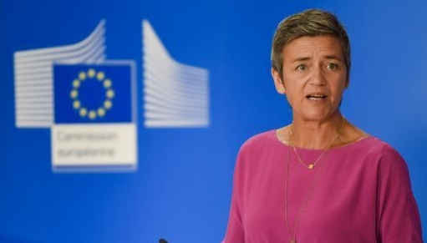
Impact on US companies
“
“
Review of US subsidies will be the ‘absolute exception’ …
subsidies that are given in the United States will be relevant to notify in the EU
”
”
Significant additional burden
Gathering information on foreign financial contributions, including wider group and (in public procurement procedures) main subcontractors and suppliers
Notification / declaration
Potentially significant consequences (e.g., exclusion from public procurements, blocking of transactions)?
Commission claims broad discretion
Impact of current relaxation of EU State aid rules?
Be prepared
Notes:
On the one hand: The FSR will certainly lead to additional „formal“ efforts for US firms participating in public procurement procedures or M&A transactions in the EU
On the other hand: It is unclear whether the FSR will actually lead to US firms being excluded from procurement procedures or transactions being prohibited. It remains to be seen how COM uses broad discretion, in particular in the application of the balancing test. For example, too strict application of the FSR could have a negative impact on competition on the European procurement markets, because it may exclude competitors offering low prices and thus indirectly also burden the taxpayer. Furthermore, the relaxation of State aid rules in the EU in March 2023 as part of the Green Deal Industrial Plan may also impact the Commission‘s assessment and result in a less strict approach towards foreign subsidies to facilitate the green transition. With regard to US firms, it is also worth noting that Art. 44 FSR makes clear that the regulation will not prevent the EU from “fulfilling its obligations under international agreements.” Existing agreements, such as the reciprocal defense procurement agreements between the U.S. and European allies which guarantee open markets in defense materiel and services, and the WTO Government Procurement Agreement, which affords parties (including the U.S.) similar rights to nondiscrimination in civilian procurements, may shape how the FSR is applied

Slide 26
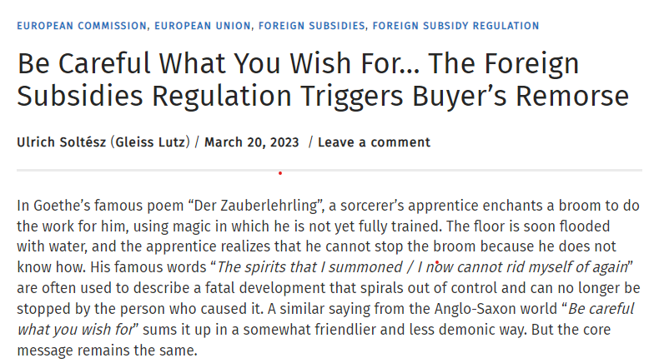
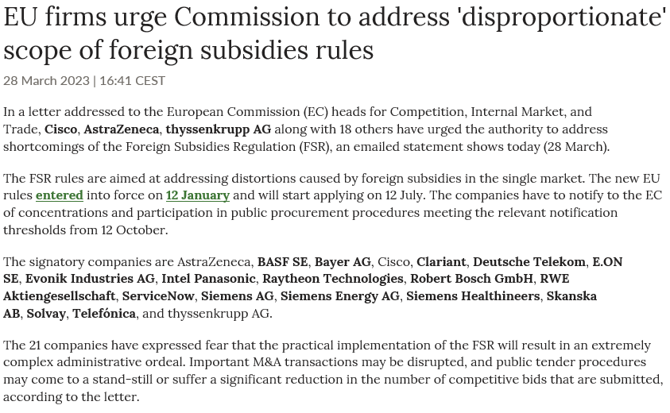
(Potential) mitigation?
Pre-notification procedure with the European Commission?
May criticism make the European Commission rethink?
Draft implementing regulation:
Possibility for companies to engage in pre-notification discusssions
Companies can ask for waivers to submit certain information required by notification form
Pre-notification may result in significant reduction of the amount of information to be submitted
Notes:
Pre-notification:
Companies subject to notification obligations are invited to engage in pre-notification discussions with the Commission. The pre-notification phase serves to discuss, among other things, the precise amount of information required in the notification. According to the draft, pre-notification may result in a significant reduction of the amount of information to be submitted to the Commission as companies can ask for waivers to submit certain information required by the notification form. The Commission intends to consider such waiver requests if the relevant information is not reasonably available or not necessary for the examination of the case. The concept of pre-notification, which is also an established step in EU merger control and State aid procedures, can thus be used to significantly limit the administrative burden and ideally shorten the overall duration of the investigation procedure before the Commission.
The adoption of the implementing regulation is planned for the second quarter of 2023.
Possibilities for an amendment of the obligations under the FSR:
Implementing act on the form, content and procedural details of notifications and declarations, including a possible simplified procedure (Art. 47)
Amendment of notification and declaration thresholds after an evaluation which may take place no shorter than two years after application (Art. 49)

Slide 27
BLOMSTEIN Partnerschaft von Rechtsanwälten mbB Dr. Pascal Friton
Oranienburger Straße 66, 10117 Berlin pascal.friton@blomstein.com
T +49 30 214 80 2700
Dr. Max Klasse
max.klasse@blomstein.com
Ramona Ader
ramona.ader@blomstein.com

Slide 28
Discussion
Jean Heilman Grier – issues in transatlantic trade
Robert Anderson – FSR and WTO agreements (GPA and Subsidies Agreement)
Christian Filippitsch, Reed Smith (Brussels): Preparing for the FSR

Slide 29
Materials and recordings at:
www.publicprocurementinternational.com
Recordings also at:
YouTube: GW Law Government Procurement Law Program

