Slide 1
The New EU Foreign Subsidies Regulation Christopher Yukins George Washington University Law School
Challenges for Public Procurement in Europe and Beyond: Concept Programme
Conference Brussels, DG Trade, June 7, 2023, 14:00 CET
Institutions for Open Societies: The Transactional State
Digital digestion - Webinar

Slide 2
Christopher Yukins -- Lynn David Research Professor in Government Procurement Law
George Washington University Law School offers JD, LLM and Masters in Law degrees in procurement law, live and online
Program founded 1960
Work nationally and internationally

Slide 3
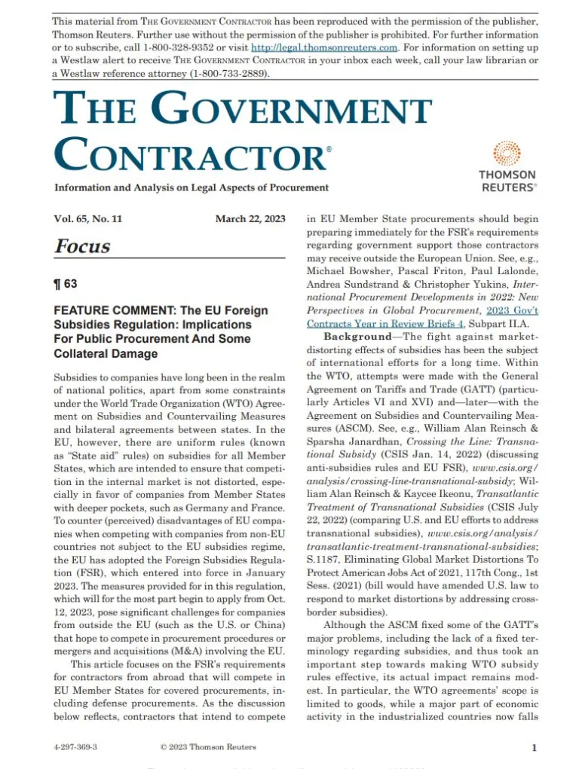
Materials and recordings from April 18, 2023 webinar at:
www.publicprocurementinternational.com
Recording also at:
YouTube: GW Law Government Procurement Law Program
Pascal Friton, Max Klasse & Christopher Yukins

Slide 4
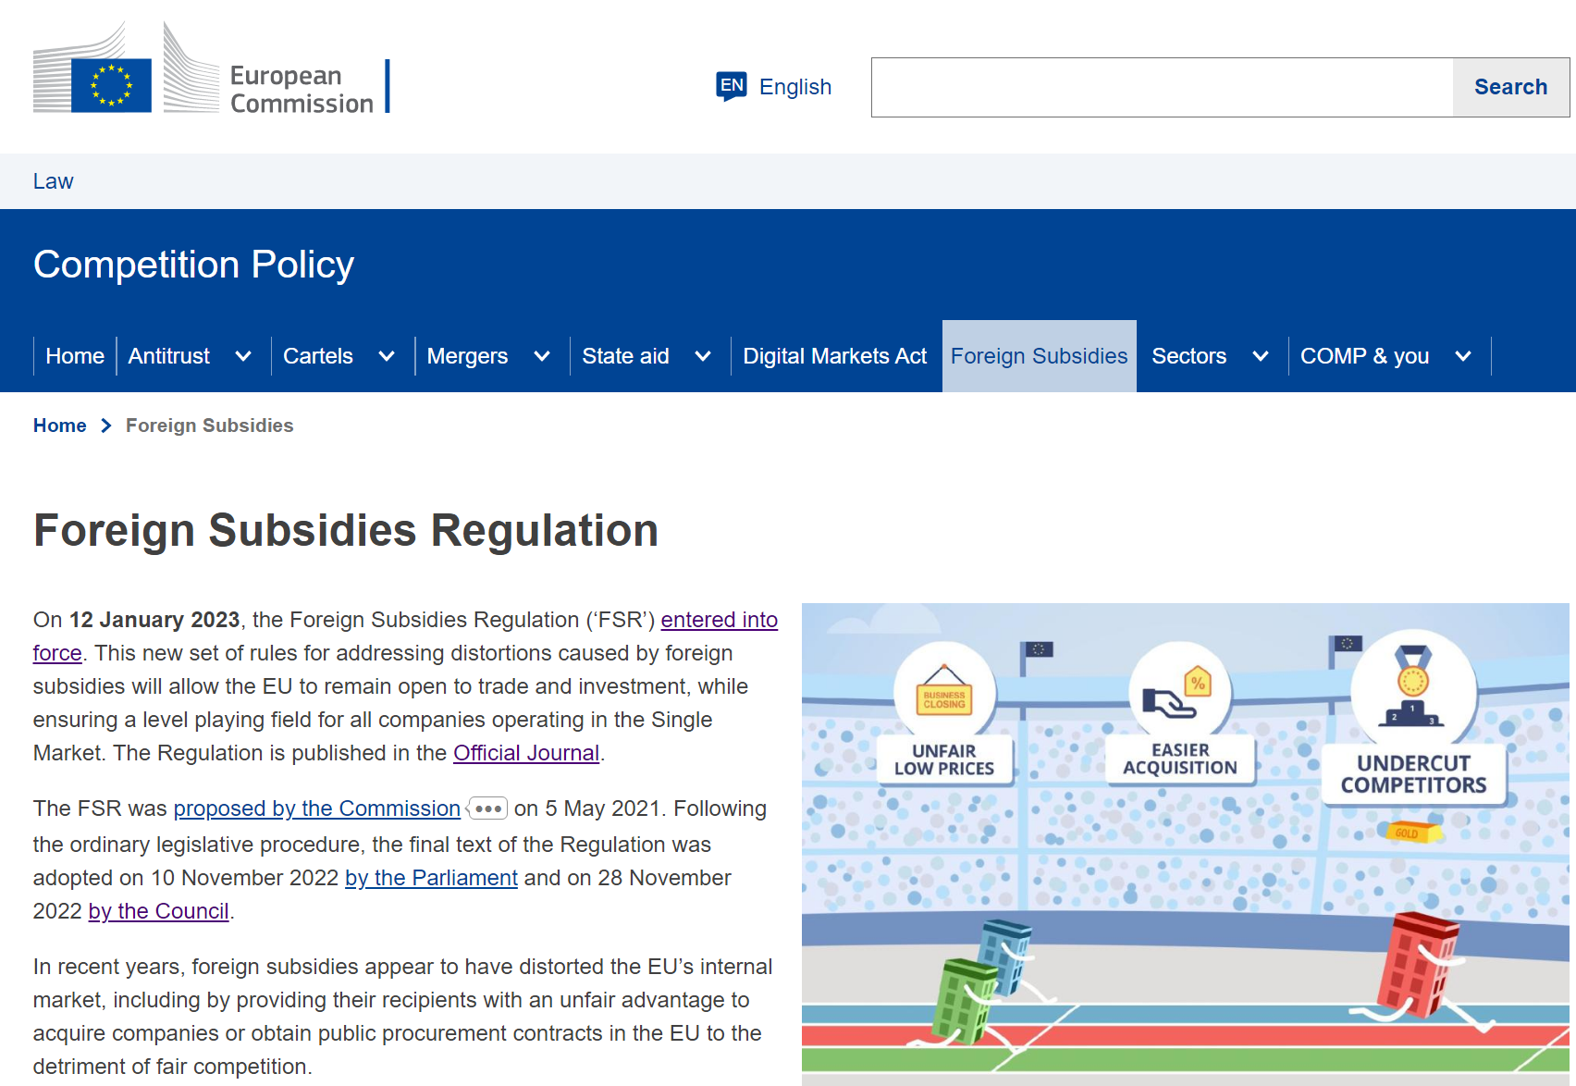
EU Foreign Subsidies Regulation (FSR)
To “level the playing field” the FSR imposes EU “State aid” doctrine on foreign vendors competing in EU Member States
Bidders must disclose foreign government subsidies
Commission will review
Applicable to civil agency procurements above 250 million Euros
European Commission may undertake ex officio investigations of defense procurements
Enormous administrative burden, including for EU-based vendors buying from abroad; may be used strategically by competitors

Slide 5
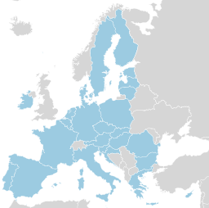
Discrimination?
EU Prime Contractor/
Procurement
Non-EU “Main” Supplier – Heavy Disclosure Obligations and Risk
EU “Main” Supplier – No Disclosure Obligations and No Risk
Notes:
Source: REGULATION (EU) 2022/2560 OF THE EUROPEAN PARLIAMENT AND OF THE COUNCIL of 14 December 2022 on foreign subsidies distorting the internal market: (54) An unduly advantageous tender could also result from foreign subsidies granted to a subcontractor or supplier because of its competitive impact on the tender submitted to a contracting authority or contracting entity. However, to limit the administrative burden, only main subcontractors or main suppliers, that is those whose products or services relate to key elements of the contract or exceed a certain percentage of the value of the contract should notify foreign financial contributions. Elements of the contract can be considered to be key elements, in particular, on the basis of the specific relevance of the element to the quality of the tender including specific know-how, technology, specialised staff, patents or similar advantages available to the subcontractor or supplier, especially where those elements are relied upon for fulfilling the majority of at least one of the selection criteria in a public procurement procedure. In order to ensure a stable factual basis for review, the preliminary review should take into account the main subcontractors and suppliers already known at the stage of the submission of the complete notification or declaration or updated notification or declaration in the case of multi-stage procedures. This Regulation should not affect the possibility for economic operators to use new subcontractors in the execution of their contracts. As a result, changing subcontractors and suppliers after the submission of the complete notification or declaration or updated notification or declaration or during the execution of a contract should not create additional notification obligations, but it should be possible for the Commission to open an ex officio review if it has information, including from any Member State, natural or legal person or association, that those subcontractors and suppliers could have benefitted from foreign subsidies.

Slide 6
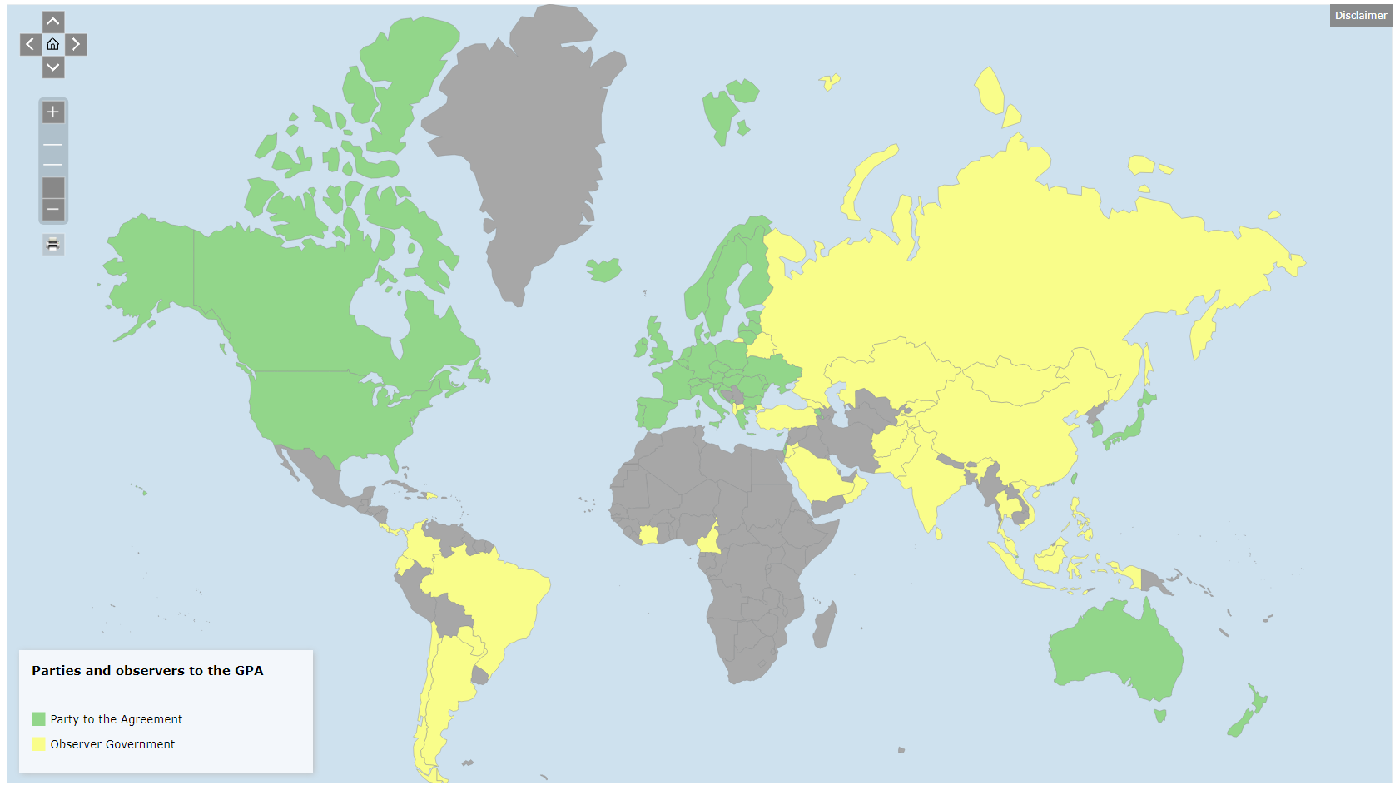
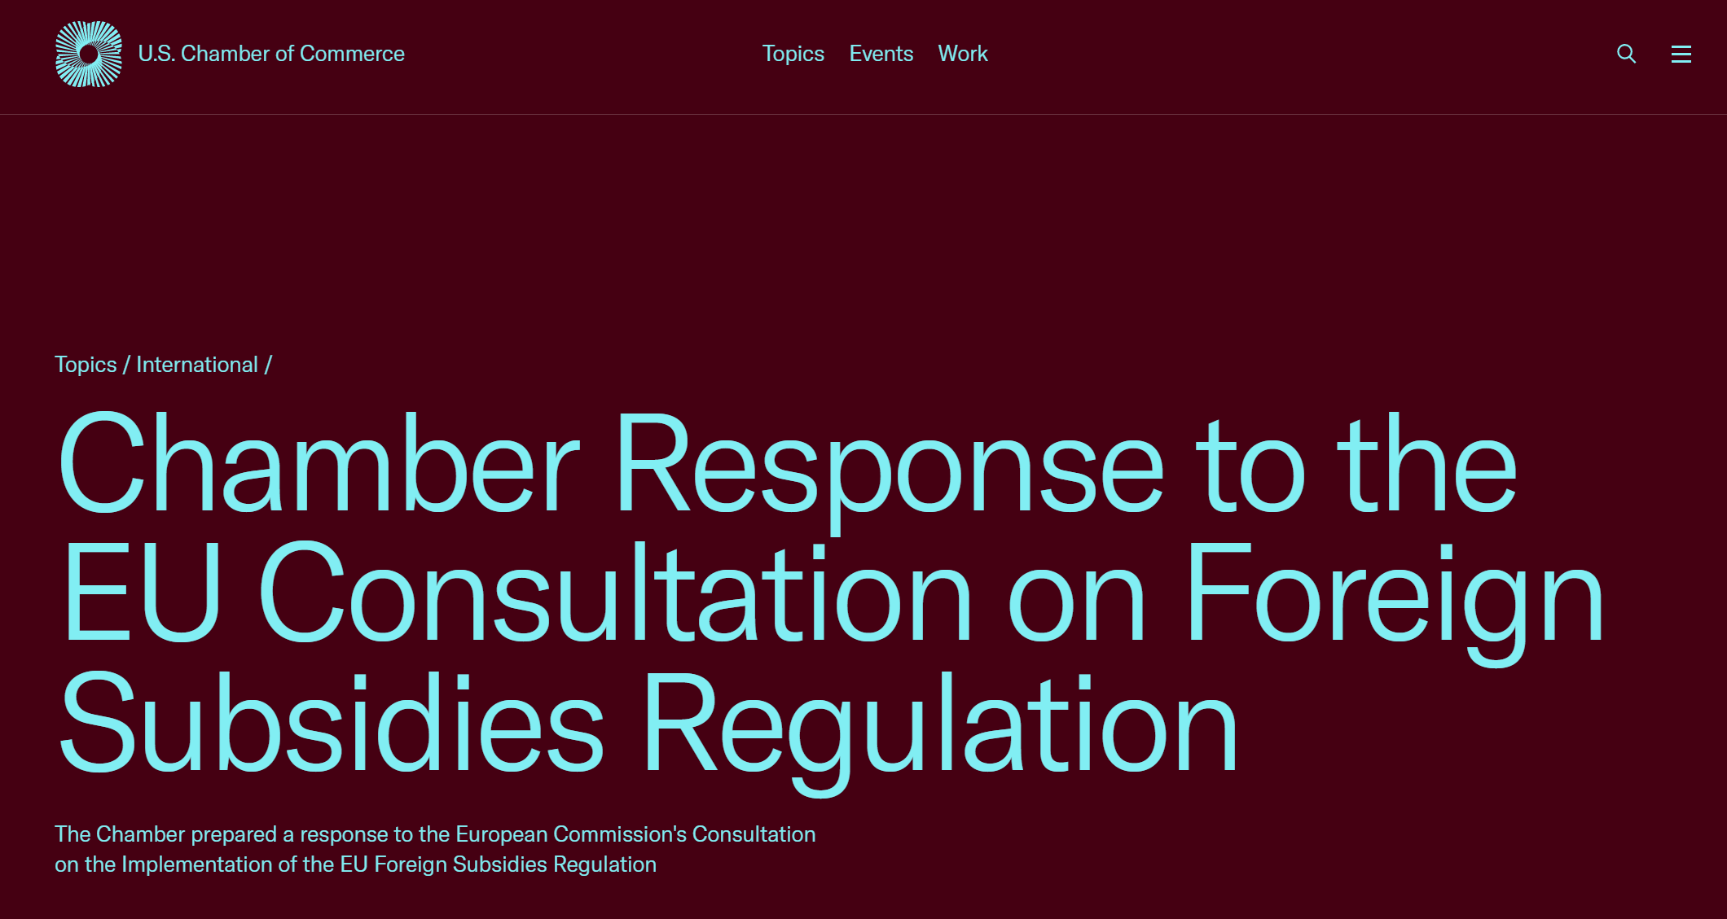
Potential Solution – Exempt WTO Government Procurement Agreement (GPA) Nations
U.S. Chamber of Commerce proposed that GPA nations be exempted from Foreign Subsidies Regulation – see generally Rebecca Hallbach & Emmanuelle Rogiest (Wolters Kluwer)
EU International Procurement Instrument (IPI) exempts GPA nations
Under Foreign Subsidies Regulation, EU-based vendor would suffer discrimination if offering goods from non-EU supplier
Article IV.2 of GPA provides that, with respect to “any measure regarding covered procurement, a Party, including its procuring entities, shall not . . . (b) discriminate against a locally established supplier on the basis that the goods or services offered by that supplier for a particular procurement are goods or services of any other Party”
Regulatory burden – if made reciprocal – could undo the GPA

Slide 7
Conclusion
cyukins@law.gwu.edu

