Slide 1
ADDRESSING MICRO-PURCHASES IN THE MPC – AS 50 STATES ALREADY HAVE
KYLE COOPERSMITH

Slide 2
FIRST, WHAT ARE MICRO-PURCHASES?

Slide 3
DEFINITION
Micro-purchases are a method of procurement for supplies or services less than $10,000. 2 C.F.R. § 200.320(a)(1)(i) (2023).
A non-Federal entity may increase the micro-purchase threshold up to $50,000 if it justifies the increase, maintains documentation for auditing, qualifies as a low-risk auditee, and does an annual internal risk assessment. 2 C.F.R. § 200.320(a)(1)(iv).
In the federal sphere, an agency head may increase the threshold to $20,000 and $35,000 respectively for contracts inside and outside of the United States if (s)he determines that the contract supports a contingency operation, responds to a cyber/nuclear/biological attack, or facilitates international disaster assistance. FAR 13.201(g).

Slide 4
PROCEDURAL REQUIREMENTS
First, “[t]o the maximum extent practicable, the non-Federal entity should distribute micro-purchases equitably among qualified suppliers.” 2 C.F.R. § 200.320(a)(1)(i) (2023). The first requirement is a “should”—funding is not withdrawn if the non-Federal entity fails to do so.
Second, the non-Federal entity must “consider[] the price to be reasonable based on research, experience, purchase history or other information and documents it files accordingly.” 2 C.F.R. § 200.320(a)(1)(ii). Even though the second requirement is a “must,” it does not require the non-Federal entity to document any research, experience, or purchase history. Simply put, the procedural requirements allow the end user to shop for supplies and services like a consumer in the commercial marketplace.

Slide 5
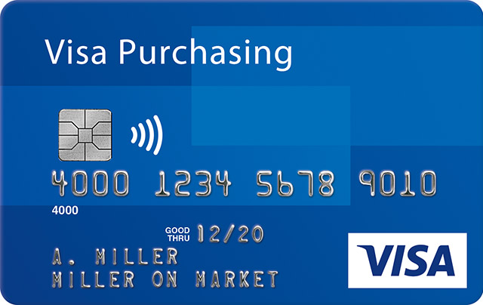
PURCHASE CARDS
A common way to make micro-purchases is through credit cards called “purchase cards,” or “P-cards.”
In the federal sphere, the government calls them “[g]overnmentwide commercial purchase card[s].” FAR 13.201.

Slide 6
SECOND, WHY ADDRESS MICRO-PURCHASES?

Slide 7
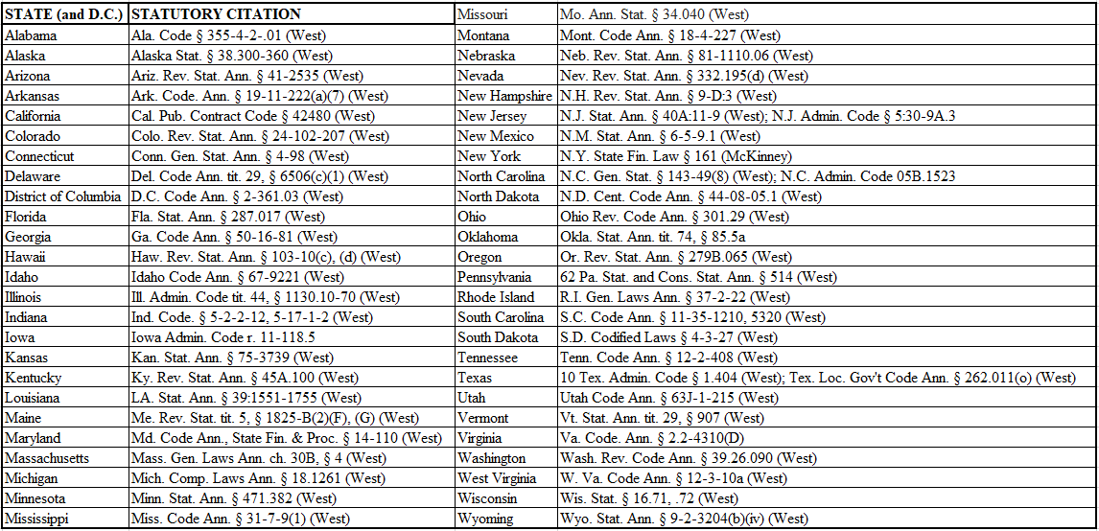
ALL 50 STATES USE MICRO-PURCHASES

Slide 8
Ohio
Ohio Rev. Code Ann. § 301.29 (2023)
- Administrative controls: an aggregate dollar amount per day, week, or month; classes of permissible goods/services; a procedure for revocation of a purchase card. (C)(1).
- Internal accounting controls in consultation with the state auditor. (C)(2).
- Appropriation method from “specific appropriation line items.” (E).
- No splitting. (F)(3).
- The purchaser carries personal liability for deficiencies between the amount appropriated and spent. (G)(1)(a).

Slide 9
West Virginia
W. Va. Code Ann. § 12-3-10a (2023)
- The State Auditor runs the program
- “Efficiency” is the stated rationale
- No cash advances, except pre-approved advances for travel
- Monthly paper invoices may be substituted for monthly purchase card charges
- The purchase card program itself is competitively bid

Slide 10
Kansas
Statute: “(e) With the approval of the secretary of administration, the director of purchases may delegate authority to any state agency to make purchases of less than $25,000 under certain prescribed conditions and procedures.” Kan. Stat. Ann. § 75-3739 (2023).
Purchase Card Program Manual: “Individual P-Card transactions are limited to $5,000 per purchase.” State Procurement Card (P-Card) Program Procedures 210 (2017).

Slide 11
BENEFITS OF MICRO-PURCHASES
Efficiency: micro-purchases “expedite the completion of its transactions and minimize the associated administrative burden and costs.” 2 C.F.R. § 200.320(a). There is no contracting officer and no binding regulations.
Lower prices: if purchase cards are used to effectuate the micro-purchase, state governments can negotiate lower prices and leverage buying power. See U.S. Gov’t Accountability Off., GAO 16-526, Government Purchase Cards: Opportunities Exist to Leverage Buying Power (2016).
End user satisfaction: if purchase cards are used to effectuate micro-purchases, the end user can shop on ecommerce platforms, e.g. Amazon, for exactly what (s)he wants. But, this comes at the expense of transparency and competition See Christopher Yukins et al., GSA’s Commercial Marketplaces Initiative: Opening Amazon & Other Private Marketplaces To Direct Purchases By Government Users, Briefing Papers at 5, No. 20-13 (Dec. 2020).
Avoid “agency problem”: if purchase cards are used, contracting officers do not “stray from the agency’s optimal outcome due to selfish interests.” Lieutenant Colonel Abraham Young, Empowering the End-User As Procurement Agent Through E-Commerce: Eliminating, Rather Than Managing, the Agency Problem, 49 Pub. Cont. L.J. 651, 652 (2020)

Slide 12
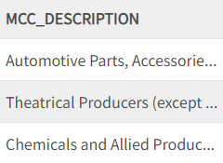
THE COMBINATION OF MICRO-PURCHASES AND PURCHASE CARDS
Purchase cards create accountability, e.g…
Regular auditing
Training programs
For example, West Virginia codified two hours of annual training for purchase card holders. See W. Va. Code Ann. § 12-3-10a.
Electronic, public lists
For example, the District of Columbia updates an electronic list with all transactions via purchase card

Slide 13
MPC’S INDIRECT CONFLICT WITH THE CFR
The Office of Management and Budget (OMB), through the Code of Federal Regulations (CFR), promulgated guidance for federal grantees that addresses five methods of procurement: micro-purchases, small purchases, sealed bids, proposals, and non-competitive procurement. 2 C.F.R. § 200.320.
The Model Procurement Code for State and Local Governments (MPC), in contrast, addresses only four of those methods. MPC § 3-203.
The MPC does not address the fifth: micro-purchases.

Slide 14
RISK OF ABUSE
Alabama’s Disciplinary System:
1st Offense - The cardholder will receive a formal written reprimand or meeting from the Comptroller’s Card Services Director. The cardholder’s agency CFO, PCard Administrator and/or agency director will be copied on the reprimand.
2nd Offense – Disable the cardholder’s PCard and Access Online usage for 3 months.
3rd Offense - If a following offense occurs the PCard and Access Online usage will be terminated indefinitely and/or employment termination.
For more serious offenses, criminal prosecution is available. See N.D. Cent. Code Ann. § 44-08-05.1 (describing the process for criminal prosecutions resulting from abuse of purchase cards).
- Risks: a government employee may “split” the costs of one transaction that would exceed the micro-purchase threshold into many, spend money on personal items, or spend money for which no funding way available.
- Mitigation: state governments may limit the availability of purchase card holders and focus training on purchase card holders

Slide 15
THIRD, HOW COULD THE MPC ADDRESS MICRO-PURCHASES?

Slide 16
PRACTICALLY
First, like the CFR, the new section could break micro-purchases down into its rationale, procedural requirements, $10,000 threshold, and procedure to increase threshold. 2 C.F.R. §200.320(a)(1) (“Micro-purchases”). This explains how to conduct a micro-purchase.
Second, like the FAR, the new section could make purchase cards the preferred method of making micro-purchases. FAR 13.2 (“Actions At or Below the Micro-Purchase Threshold”). Purchase cards: (1) are efficient, (2) lower prices, (3) create accountability, (4) increase end user satisfaction.
Third, like Ohio’s state law, the new section could establish state government administration of the purchase card program, including an administrative board that oversees auditing, training, and investigations. See Ohio Rev. Code Ann. § 301.29. This function is necessary to maintain the integrity of micro-purchases and the purchase card program.

Slide 17
POLITICALLY
If micro-purchases are made through purchase cards on ecommerce platforms, e.g. Amazon, competition issues may arise.
Note: the Federal Trade Commission recently filed an antitrust lawsuit against Amazon.
In that case, government employees using a purchase card would need to be careful about their first procedural requirement: “To the maximum extent practicable, the non-Federal entity should distribute micro-purchases equitably among qualified suppliers.” 2 C.F.R. § 200.320(a)(1)(i).

Slide 18
CONCLUSION Kyle Coopersmith kylecoopersmith@gmail.com

