Slide 1
Prohibition list of economic operators
CHIȘINĂU
07 December 2018

Slide 2
Short history
Regulation on how to draw up and record the Prohibition List of suppliers (contractors) participating in public procurement procedures approved by H.G. no. 105 of 30.01.2006 | Regulation on how to draw up and record the list of banned economic operators approved by H.G. no. 45 of 24.01.2008 | Regulation on how to draw up the list of banned economic operators approved by H.G. no. 1418 of 28.12.2016
Drawing up and keeping the List in handwritten and electronic form. | The compilation and maintenance of the List shall be carried out in manual and electronic form. | The List shall be drawn up, maintained and updated electronically.
At the request of AC. | At the request of the CA or the inspection body. | At the request of AC, AAP, ANSC.
The term for which it is included in the O.C. List is 1 year. | The term for which it is included in the E.O. List is 3 years. | The term for which it is included in the E.O. List is 3 years. (The E.O. founder cannot participate in public procurement procedures).

Slide 3
Grounds for registration
H.G. no. 105 of 30.01.2006 | H.G. no. 45 of 24.01.2008 | H. G. no. 1418 of 28.12.2016
there is a final decision of the court of judgment terminating the contracts of purchases as a result of non-compliance or improper fulfilment by the E.O. the contractual terms; | there is a final decision of the court of judgment terminating the contracts of purchases as a result of non-compliance or improper fulfilment by the E.O. the contractual terms; | there is a final court judgment the judgment terminating the contract of purchases as a result of non-compliance or improper performance by the economic operator of the contractual clauses;
the presentation of false documents in public procurement procedures; | the presentation of false documents in public procurement procedures; E.O. does not fulfil its obligations contract, deliver goods, provide services or carries out work on their own initiative, other than those provided for in the contract, or the quality goods, services and works is lower than that provided for in the contract and in documents relating to the conduct of the purchase; | the presentation of false documents in public procurement procedures. E.O. does not fulfil its obligations contract, deliver goods, provide services or carries out work on their own initiative, other than those provided for in the contract, or the quality goods, services and works is lower than that stipulated in the contract and in the documents on the conduct of the procurement procedure;
there is a final judgment of the court of judgment finding a case of corruption on the part of the supplier (contractor) for the purpose of taking certain actions, adopting decisions or the application of procedures of purchases in his favour. | there is a final judgment of the court of judgment, which found that the defendant had committed to the E.O. of economic fraud or a corruption case from the E.O. for the purpose of to take certain actions, adopt certain decisions or the application of procurement procedures in his favor. there is evidence presented by A.C. or the inspection body which demonstrates that O.E. with the same founders participated in the procurement procedures by creating a unfair competition and pricing higher than those available on the market. | there is evidence presented by the authority contracting authority or the inspection body which demonstrates that the EEO participated in the procurement procedure with rigged bids, have participated as members of the group of undertakings dependent on the same procurement procedure public with several offers or created a unfair competition between participants.

Slide 4
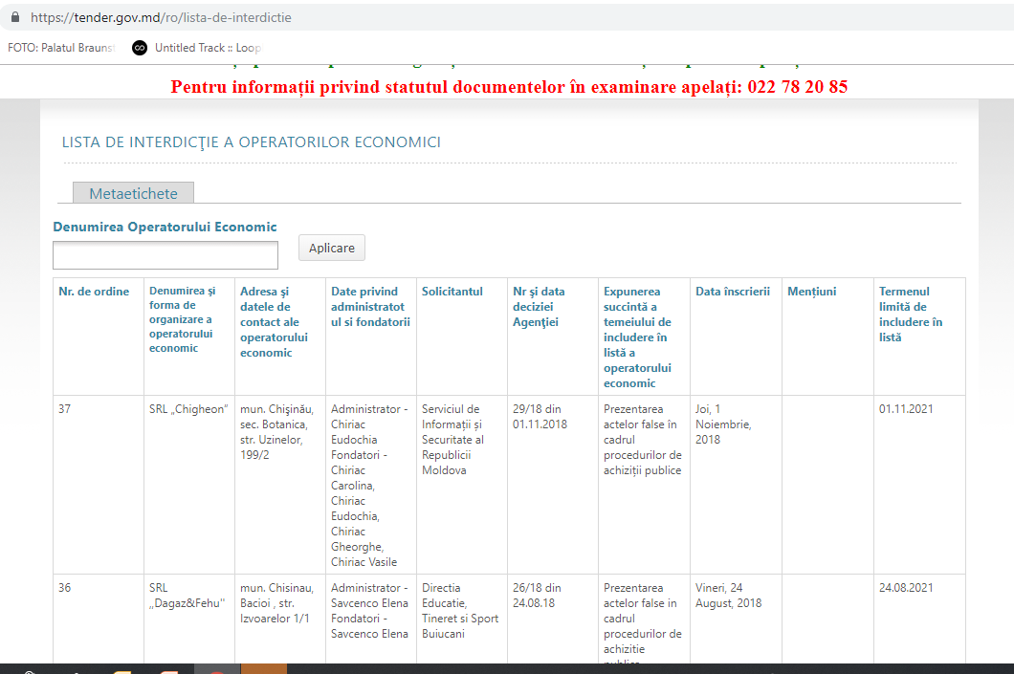
Currently

Slide 5
Currently
Number of EOs on the List

Slide 6
Thank you for your attention!
Public Procurement Agency
E-mail: BAP@tender.gov.md
Web: www.tender.gov.md
Phone: (022) 23-42-80
Fax: (022) 73-33-00
Helpdesk: (022) 78-20-86

