Slide 1


Training Webinar:
AIRC Report on U.S. Labor Law Violations and Mandatory Debarment
12 September 2023 – 11 am Eastern with the kind cooperation of the Defense Acquisition University

Slide 2

Co-Host – Dave Drabkin
Independent consultant with 45-plus years of federal government contracting experience in both the public and private sector.
He is an AIRC Fellow, Acquisition Innovation Research Center, SERC, Stevens Institute of Technology.
He serves as the Chair of the Procurement Round Table, www.procurementroundtable.org
He served as the Chairman of The Advisory Panel on Streamlining and Codifying Acquisition Regulations (Section 809 Panel), https://discover.dtic.mil/section-809-panel/
The President of the United States appointed Dave to the Service Acquisition Reform Act (SARA) and the Multiple Award Schedule (MAS) Panels.
He served as:
  Senior Procurement Executive, General Services Administration
  Deputy Program Manager, Pentagon Renovation Program
  DoD Program Manager for Federal Acquisition Streamlining Act (FASA) Implementation.
Dave has also worked in numerous positions in the DoD, the Homeland Security and Government Affairs Committee (HSGAC) of the U.S. Senate. After leaving the Federal government he worked for Northrop Grumman Corporation and Dixon Hughes Goodman, LLP.

Slide 3

Co-Host – Professor Chris Yukins
Christopher R. Yukins has many years of experience in public procurement law. He was for several years a trial attorney with the U.S. Department of Justice, where he handled trials and appeals involving bid protests and contract claims against the U.S. government.
Chris is an AIRC Fellow, Acquisition Innovation Research Center, SERC, Stevens Institute of Technology.
He is the Lynn David Research Professor in Government Procurement Law, George Washington University School of Law, George Washington University, Washington DC, where he teaches government contract formations and performance issues, bid protests, Contract Disputes Act litigation, and comparative issues in public procurement, and focuses especially on emerging public policy questions in U.S. procurement.
He is an active member of the Public Contract Law Section of the American Bar Association, serves on the steering committee to the International Procurement Committee of the ABA International Law Section, and previously served as the president of the Tysons Corner Chapter of the National Contract Management Association.
He is a faculty advisor to the Public Contract Law Journal, and has contributed pieces on procurement reform, international procurement, electronic commerce and information technology to a broad range of journals, including Washington Technology, Government Contractor, Legal Times, and Federal Computer Week. He has published on procurement reform in scholarly journals, including the Public Contract Law Journal, Georgetown Journal of International Law, and Public Procurement Law Review (United Kingdom).
Together with his colleagues, he runs a popular colloquium series on procurement reform at The George Washington University Law School. In private practice, Professor Yukins has been an associate, partner, and of counsel at leading national firms; he is currently of counsel to the firm of Arnold & Porter LLP.
He was an advisor to the U.S. delegation to the working group on reform of the United Nations Commission on International Trade Law (UNCITRAL) Model Procurement Law, and he teaches and speaks often on issues of comparative and international procurement law.

Slide 4
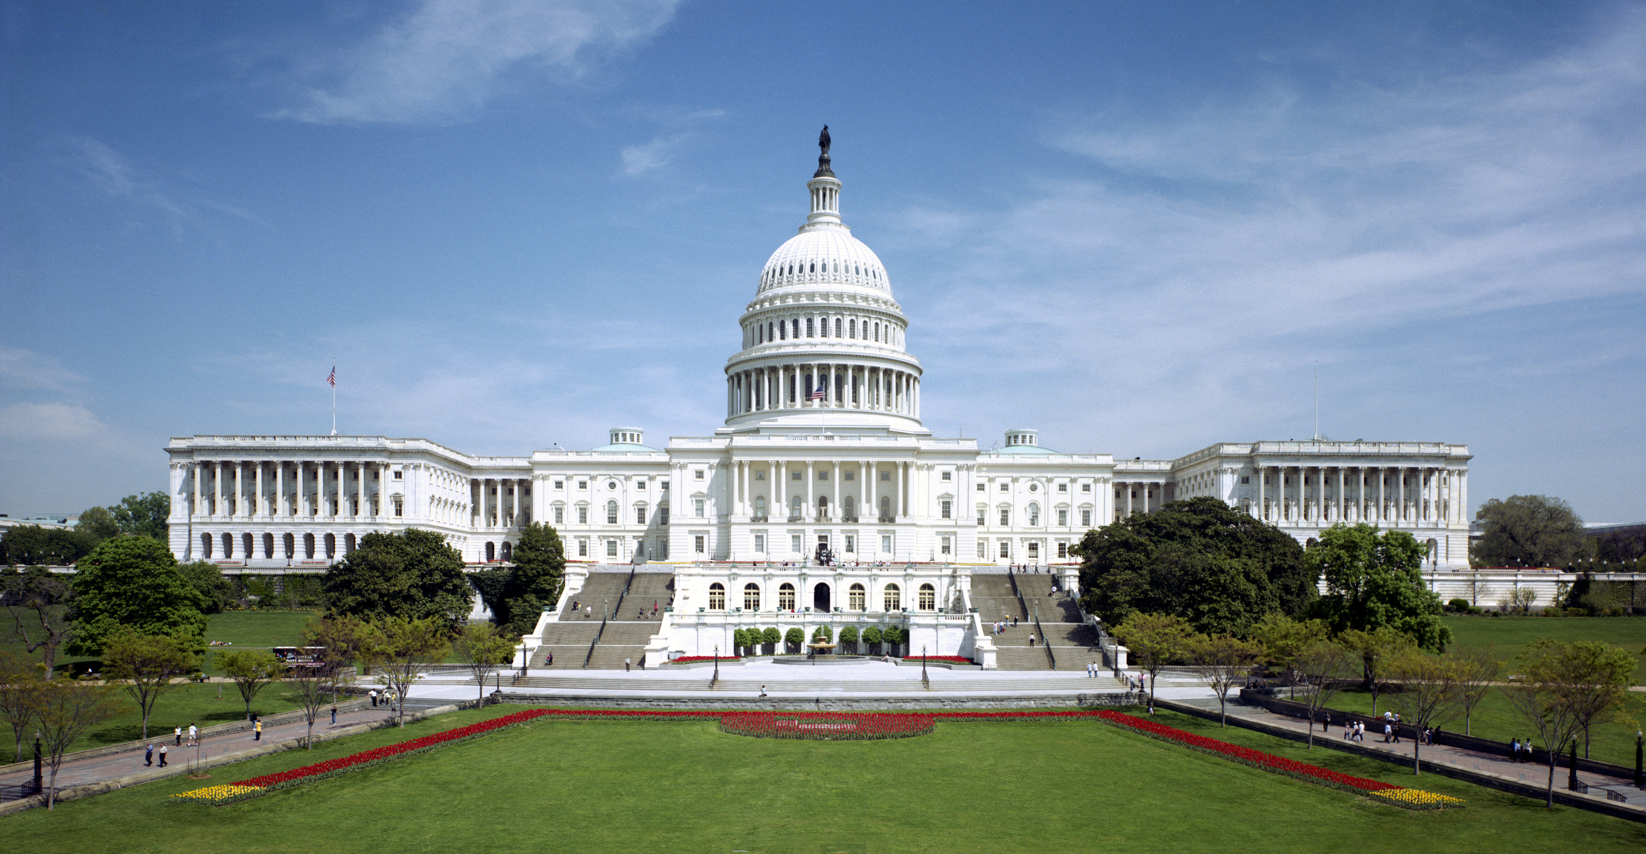
Follow-Up: Congressional Direction
-- Joint Explanatory Statement for NDAA FY2023
Prohibition on contracting with employers that violated the National Labor Relations Act: The House bill contained a provision (sec. 868) that would prohibit the Secretary of Defense from entering into a contract with an employer found to have violated section 8(a) of the National Labor Relations Act (Public Law 74-198) during the 3- year period preceding the proposed date of award of the contract. The Senate amendment contained no similar provision. The agreement does not include this provision. We note that if an offeror is found to have received final adjudication of a violation of the National Labor Relations Act, a contracting officer has authority to determine the offeror not responsible, thereby disqualifying it from award of a contract. However, as the Acquisition Innovation Research Center (AIRC) stated in a report titled “Congressionally Mandated Study on Contractor Debarments for Violations of U.S. Labor Laws,” published pursuant to the Joint Explanatory Statement to Accompany the National Defense Authorization Act for Fiscal Year 2022 (Committee Print No. 2), contracting officers “are tasked with a myriad of responsibilities throughout the acquisition lifecycle….[and in] making their responsibility determinations Contracting Officers often do not have the necessary information or knowledge base to make informed decisions regarding the relevance and weight of various labor law violations.” Recent reports from the Comptroller General of the United States indicate efforts are underway to improve information sharing between the Department of Labor and Federal agencies to ensure access to comprehensive and accurate information when making such responsibility determinations, however, in its report the AIRC observed such information transfer may not provide contracting officers or suspension and debarment officers the context and background needed to make fully informed decisions. The AIRC recommends additional training for contracting officers in how to find and assess data regarding labor violations and suggests requiring contractors to submit data regarding finally adjudicated labor law violations as part of regular representations and certifications to improve transparency, accuracy, and decision-making. We therefore direct the AIRC to post the aforementioned report on its publicly accessible website and encourage the Under Secretary of Defense for Acquisition and Sustainment to host a conference with AIRC, and participants from government, industry, and academia, and create a summary of such conference, to improve reporting processes and understanding of labor violations within the existing statutory and regulatory framework.

Slide 5
Training Webinars: 2 x 2 hours
September 12: On using labor violation data for consideration in responsibility determinations and debarments, per the congressional direction
October 4 panelists:
  Senior officials from the Labor Department
    Solicitor General's Office
    Wage & Hour Division
  Member, federal debarment community
  Senior procurement official
  Member of the bar
  Moderators: David Drabkin & Christopher Yukins
Session 1: Background
Session 2: Accessing and considering labor violation data

Slide 6
Background to AIRC Study on Debarments
The Acquisition Innovation Research Center (AIRC) was established in September 2020 by the Department of Defense (DoD) to infuse innovation and alternative disciplines from academia to better respond to rapidly changing threats and technological advances.
Principal investigators on this initiative:
  David Drabkin - former GSA Senior Procurement Executive and debarment official; previous chair of Section 809 panel on acquisition reform, including on bid protests
  Christopher Yukins - George Washington University Law School; author of prior study for Administrative Conference of the United States (ACUS) on agency-level protests
Researchers:
  Will Dawson – GW Law, JD 2022
  Jonathan O’Connell – GW Law, LLM candidate; labor/employment attorney, government & private sector
  Roxanne Reinhardt – GW Law, JD 2022; research assistant
  Brandon Hancock – GW Law, JD candidate; research assistant
  Sharjeel Chaudhry – Federal Consult; data analyst

Slide 7
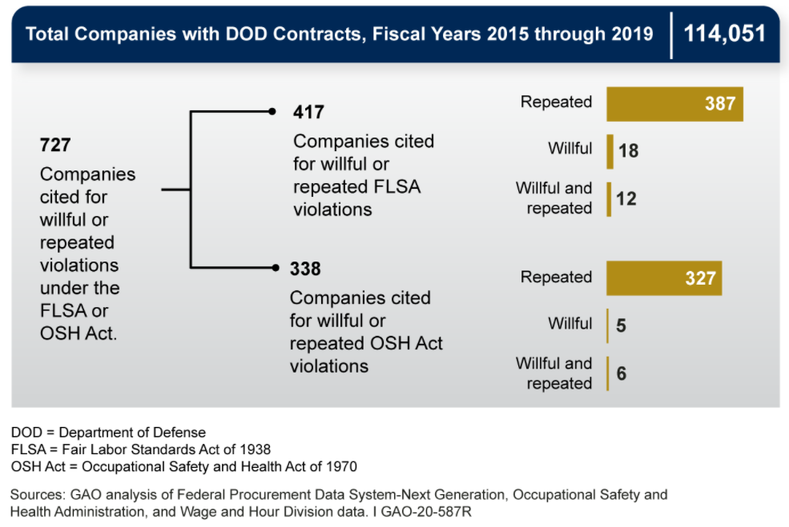
GAO Report
2020
“Because of limitations in available data, GAO could not determine the total incidence of willful or repeated violations of safety, health, or fair labor standards among all companies with a defense contract in this 5-year time frame.”
“For fiscal years 2015 through 2019, about 114,000 companies had contracts with DOD, totaling approximately $1.7 trillion in obligations. Of those companies, at least 727 (about 1 percent) had been cited for willful or repeated violations under the OSH Act or the FLSA over this time frame. . . . Available data generally do not indicate whether the violations occurred while the employees were performing work related to a DOD contract.”
“For the same time frame, these 727 companies had $208.5 billion in DOD contract obligations (about 12 percent of the total), and represent a range of industries, including manufacturing; professional, scientific, and technical services; and construction.”
“. . . the most frequently found willful or repeated fair labor violations related to failure to pay overtime.”
Notes:
https://www.gao.gov/products/gao-20-587r

Slide 8

Debarment Study
Pending legislation would have debarred vendors that violate certain U.S. labor laws
Report assessed:
Likely impacts of automatic debarment on Defense Industrial Base/supply chain
Options: (1) Dept of Labor debarment; (2) customer agencies’ debarments; (3) contracting officer’s responsibility determinations; (4) contractor reporting

Slide 9
Exclusion/Debarment Approaches
Non-Responsibility Determination
By contracting officer
Discretionary Debarment
Suspension & Debarment Official (SDO) has broad discretion to make business decision
Focus on performance risk, cognizant of government’s reputational and supply chain risk
Enforcement – Statutory Debarment
Also known as “inducement” --debarments based on violations of statute (see next slide)
For each procurement
Focus: performance risk
Not necessarily tied to supply chain or performance risk

Slide 10
Congress Called for Assessment of Adjudicative Debarments
Not used by U.S. agencies – used by other institutions, e.g., World Bank
Typically focused on “punishment” for certain bad acts
Not focused on supply chain or performance risk

Slide 11
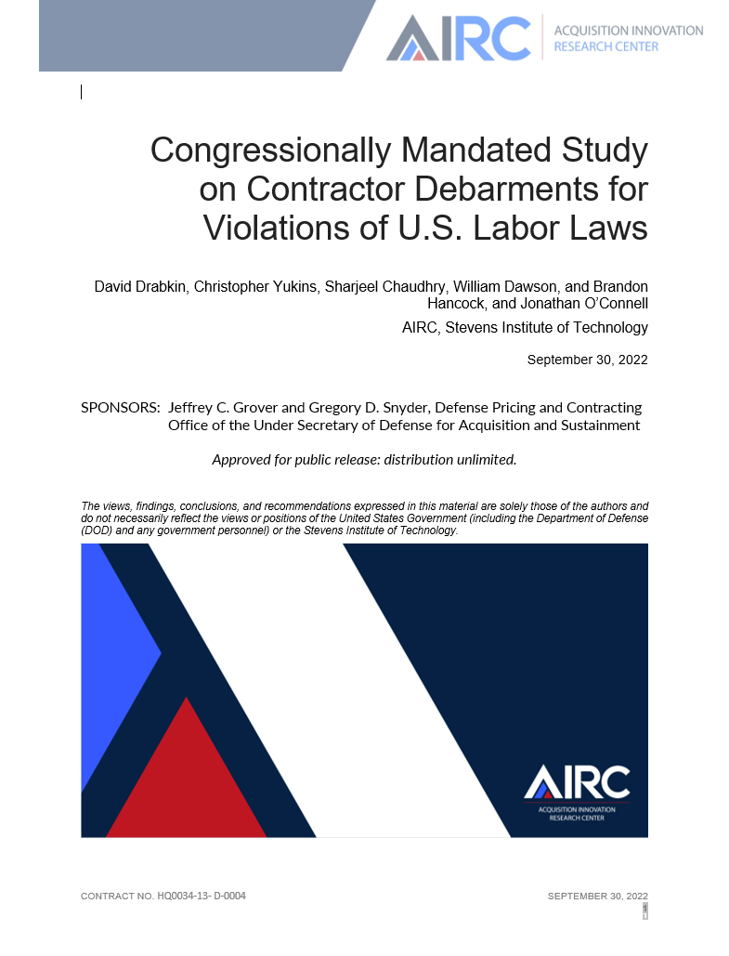
Final Report:
30 September 2022

Slide 12
Report included:
Background regarding AIRC, and congressional directions
Key issues
  Overview of “responsibility”
  Statutory (sometimes called “mandatory”) vs. discretionary debarments
  Risk of debarment to the Defense Industrial Base (DIB)
U.S. labor laws applicable to federal contractors
Current use of statutory and discretionary debarment tools to protect government’s interests, and supply chain considerations re: increased use of debarment for labor law violations
Conclusions and potential next steps for review

Slide 13
Congressional Mandate –
NDAA FY21 Conference Report
The conferees note that the Department of Defense continues to award contracts to companies cited for willful or repeated fair labor standards violations under the Fair Labor Standards Act of 1938 (FLSA). The conferees note the National Defense Authorization Act for 2020 (Public Law 116-92) established section 2509 of title 10, United States Code, pertaining to the integrity of the defense industrial base, which included directing attention to contractor behavior that constitutes violations of the law, fraud, and associated remedies, including suspension and debarment.
The conferees further note that a July 2020 Government Accountability Office (GAO) report, titled “Defense Contractors: Information on Violations of Safety, Health, and Fair Labor Standards” (GAO-20-587R), mandated by the National Defense Authorization Act for Fiscal Year 2020, reviewing data from 2015-2019, determined that 417 companies had been cited for willful or repeated violations of FLSA pertaining to minimum wage, overtime, or child labor. Specifically, GAO found almost 5,200 such violations, most frequently, failures to pay minimum wage, overtime, and to keep accurate records. The conferees note that these companies, representing less than half of one percent of the companies the Department does business with, could potentially be replaced by more responsible contractors in order to improve the integrity of the industrial base, and potentially reward companies with better records of performance in these matters.

Slide 14
Further Congressional Direction
-- NDAA FY22 Joint Explanatory Statement
[T]he AIRC study is ongoing and we encourage the academic researchers to refine the focus of their efforts to study and make recommendations related to: (1) The impact of labor violations on the supply chain, balanced with the need to consider participation by small businesses, which tend to be more adversely impacted by debarment; (2) The availability of Fair Labor Standards Act (FLSA) records to Department of Defense contracting officers and the need for increased transparency and workforce training on labor laws and FLSA enforcement; and (3) The extent to which the current discretionary model of debarment best serves the government’s interest, or whether an adjudicatory model should be considered.

Slide 15
Possible Approaches to Labor Violations
Department of Labor – both mandatory and discretionary
Contracting Agency Discretionary Debarments
Contracting Officers’ Responsibility Determinations
Vendor Reporting

Slide 16

Elements of Responsibility (FAR Subpart 9.1)
To be determined responsible, a prospective contractor must-
(a) Have adequate financial resources to perform the contract, or the ability to obtain them (see 9.104-3(a)).
(b) Be able to comply with the required or proposed delivery or performance schedule, taking into consideration all existing commercial and governmental business commitments.
(c) Have a satisfactory performance record (see 9.104-3(b) and subpart 42.15). A prospective contractor shall not be determined responsible or nonresponsible solely on the basis of a lack of relevant performance history, except as provided in 9.104-2.
(d) Have a satisfactory record of integrity and business ethics (for example, see subpart 42.15).
(e) Have the necessary organization, experience, accounting and operational controls, and technical skills, or the ability to obtain them (including, as appropriate, such elements as production control procedures, property control systems, quality assurance measures, and safety programs applicable to materials to be produced or services to be performed by the prospective contractor and subcontractors). (See 9.104-3(a).)
(f) Have the necessary production, construction, and technical equipment and facilities, or the ability to obtain them (see 9.104-3(a)); and
(g) Be otherwise qualified and eligible to receive an award under applicable laws and regulations (see also inverted domestic corporation prohibition at 9.108).

Slide 17
Grounds for Debarment (FAR Subpart 9.4)
9.406-1 General.
(a) It is the debarring official’s responsibility to determine whether debarment is in the Government’s interest. The debarring official may, in the public interest, debar a contractor for any of the causes in 9.406-2, using the procedures in 9.406-3. The existence of a cause for debarment, however, does not necessarily require that the contractor be debarred; the seriousness of the contractor’s acts or omissions and any remedial measures or mitigating factors should be considered in making any debarment decision. Before arriving at any debarment decision, the debarring official should consider factors such as the following:
(1) Whether the contractor had effective standards of conduct and internal control systems in place at the time of the activity which constitutes cause for debarment or had adopted such procedures prior to any Government investigation of the activity cited as a cause for debarment.
(2) Whether the contractor brought the activity cited as a cause for debarment to the attention of the appropriate Government agency in a timely manner.
(3) Whether the contractor has fully investigated the circumstances surrounding the cause for debarment and, if so, made the result of the investigation available to the debarring official.
(4) Whether the contractor cooperated fully with Government agencies during the investigation and any court or administrative action.
(5) Whether the contractor has paid or has agreed to pay all criminal, civil, and administrative liability for the improper activity, including any investigative or administrative costs incurred by the Government, and has made or agreed to make full restitution.
(6) Whether the contractor has taken appropriate disciplinary action against the individuals responsible for the activity which constitutes cause for debarment.
(7) Whether the contractor has implemented or agreed to implement remedial measures, including any identified by the Government.
(8) Whether the contractor has instituted or agreed to institute new or revised review and control procedures and ethics training programs.
(9) Whether the contractor has had adequate time to eliminate the circumstances within the contractor’s organization that led to the cause for debarment.
(10) Whether the contractor’s management recognizes and understands the seriousness of the misconduct giving rise to the cause for debarment and has implemented programs to prevent recurrence.
The existence or nonexistence of any mitigating factors or remedial measures such as set forth in this paragraph (a) is not necessarily determinative of a contractor’s present responsibility. Accordingly, if a cause for debarment exists, the contractor has the burden of demonstrating, to the satisfaction of the debarring official, its present responsibility and that debarment is not necessary.

Slide 18
Debarment -- Overview
Debarment—whether statutory or discretionary—is a safeguard that prevents the government from forming contracts with contractors in violation of federal labor laws while still facilitating full and open competition in the contracting process.
Debarment in government contracts is not—and has never been—designed as a punitive tool to sanction federal contractors that have previously violated federal laws.
  FAR 9.402(b) states explicitly that the “serious nature of debarment and suspension requires that these sanctions be imposed only in the public interest for the government’s protection and not for purposes of punishment. Agencies shall impose debarment or suspension to protect the government’s interest and only for the causes and in accordance with the procedures set forth in this subpart.”
In practice, the same limiting principle applies to contractors subject to statutory debarment for violations of U.S. labor laws: only a small portion of violators are actually debarred, and statutory debarment will turn in part upon the violating contractor’s failure to undertake remedial measures to comply with applicable labor laws.

Slide 19
Selected
Statutory Debarment Grounds
Statute (Red=mandatory debarment Yellow=discretionary CAPS=labor-related)
American Technology Preeminence Act (false “Made in America” label)
Buy American Act
Clean Air Act
Clean Water Act
DAVIS-BACON ACT
Disaster Mitigation Act (false “Made in America” label)
DRUG-FREE WORKPLACE
Foreign Relations Authorization Act (false “Made in America” label)
John Warner NDAA (specialty metals noncompliance)
Military Recruiting on Campus
NDAA for FY1993 (false “Made in America” label)
SERVICE CONTRACT ACT
Small Business Act (misrepresentation as to size or status)
Sudan Accountability and Divestment Act
Veterans Benefits Act (misrepresentation as veteran-owned small business)
Walsh-Healey Act (minimum wage, uncompensated overtime, hazardous work, etc.)
Water Resources Development Act (false Made in America” label)
Notes:
Source: Congressional Research Service (2015), https://www.everycrsreport.com/files/20150527_RL34753_b03ffb412fc08224e614b62717922f8e424a46cf.pdf.

Slide 20

Department of Labor:
Statutory Debarment Exit
The Labor Department’s regulations explain the circumstances under which a firm can petition to remove itself from the statutory debarment list for violations of certain labor laws, based upon restitution to employees and compliance measures:
  Any person or firm debarred under . . . of this section may in writing request removal from the debarment list after six months from the date of publication by the Comptroller General of such person or firm's name on the ineligible list. Such a request . . . shall contain a full explanation of the reasons why such person or firm should be removed from the ineligible list. In cases where the contractor or subcontractor failed to make full restitution to all underpaid employees, a request for removal will not be considered until such underpayments are made. In all other cases, the Administrator will examine the facts and circumstances surrounding the violative practices which caused the debarment and issue a decision as to whether or not such person or firm has demonstrated a current responsibility to comply with the labor standards provisions of the [relevant] statutes . . . and therefore should be removed from the ineligible list. Among the factors to be considered in reaching such a decision are the severity of the violations, the contractor or subcontractor's attitude towards compliance, and the past compliance history of the firm. In no case will such removal be effected unless the Administrator determines after an investigation that such person or firm is in compliance with the labor standards provisions applicable to Federal contracts and federally assisted construction work subject to any of the applicable statutes listed . . . and other labor statutes providing wage protection, such as the Service Contract Act, the Walsh-Healey Public Contracts Act, and the Fair Labor Standards Act.
29 C.F.R. § 5.12, Debarment Proceedings (emphasis added). The Labor Department thus allows contractors debarred because of certain types of labor violations to “reenter” the federal market, by showing that they have undertaken compliance and remedial measures. This approach—grounded in responsibility, risk mitigation and, where appropriate, restitution—echoes the risk-based approach to discretionary debarments called for under FAR 9.406-1.

Slide 21


Agencies’ Discretionary Debarments
It is the debarring official’s responsibility to determine whether debarment is in the Government’s interest. The debarring official may, in the public interest, debar a contractor for any of the causes in 9.406-2, using the procedures in 9.406-3. The existence of a cause for debarment, however, does not necessarily require that the contractor be debarred; the seriousness of the contractor’s acts or omissions and any remedial measures or mitigating factors should be considered in making any debarment decision.

Slide 22
Discretionary Debarment for Labor Violations
Regarding labor law violations specifically, the use of discretionary debarment is used sparingly.
Contracting officials and SDOs have confirmed that contracting agencies rarely have the expertise and background information to initiate discretionary debarment actions based on labor law violations.
Further, while the Department of Labor does have discretionary debarment authority, research indicates that the Labor Department reserves its use of discretionary debarment to address labor law violations for instances in which there is an associated criminal indictment.
  This limitation is explained by the fact that, as noted above, discretionary debarment necessitates the provision of due process procedures.
  Given limitations associated with DOL’s resources, scenarios in which there are criminal indictments associated with labor law violations eliminate the need for DOL to provide due process protections, per FAR 9.406-2(a).

Slide 23
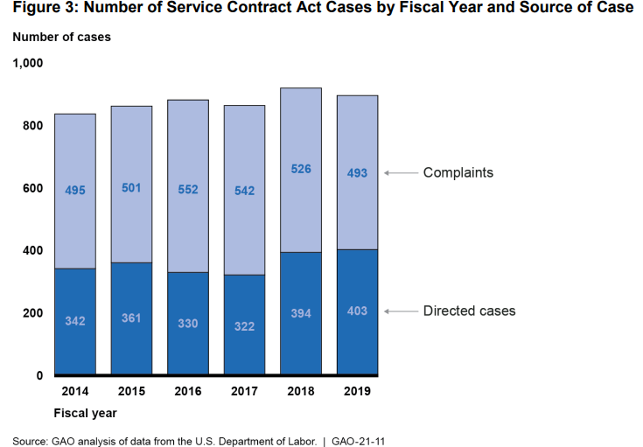
Statutory Debarments – Labor Violations
In practice, the Labor Department does not impose statutory debarment upon federal contractors in the vast majority of cases of non-compliance with statutes that mandate debarment.

Slide 24
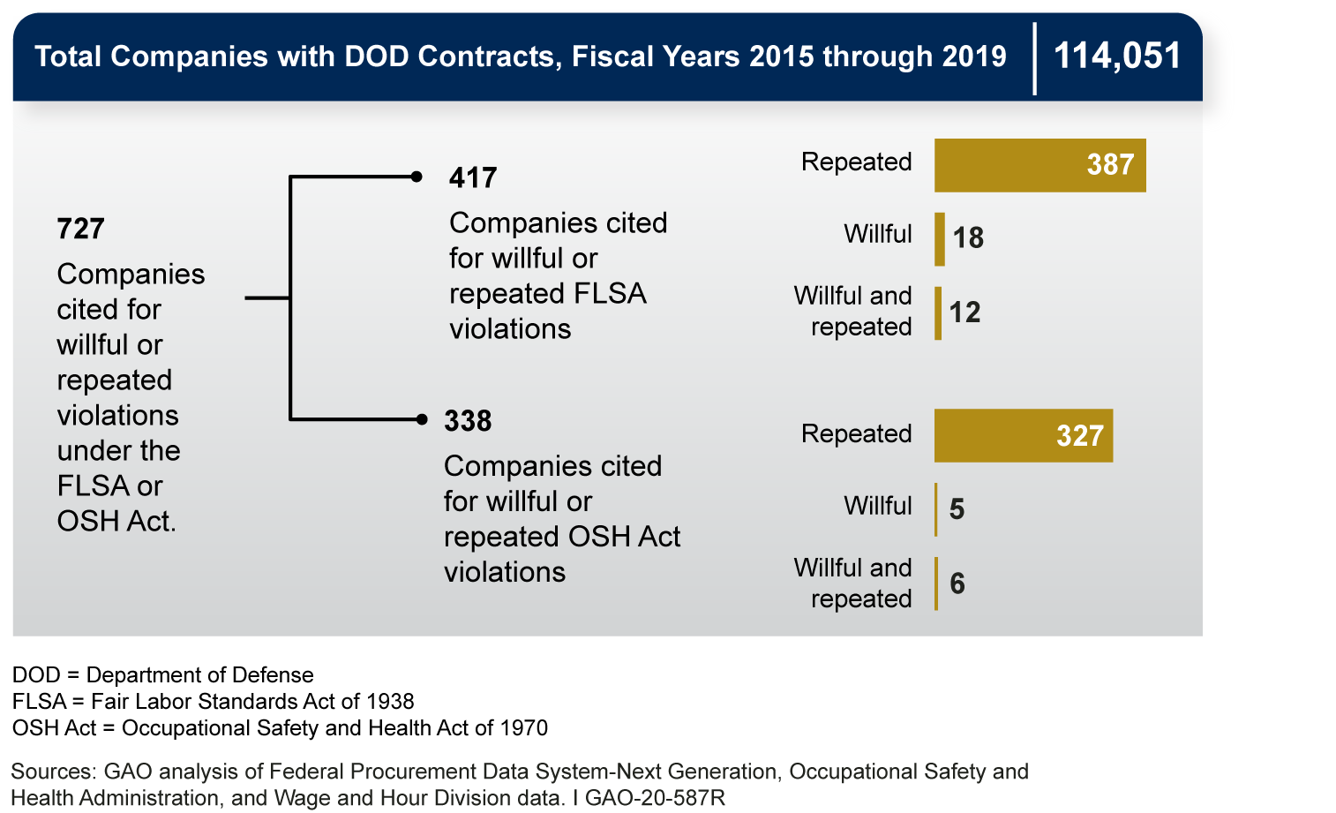
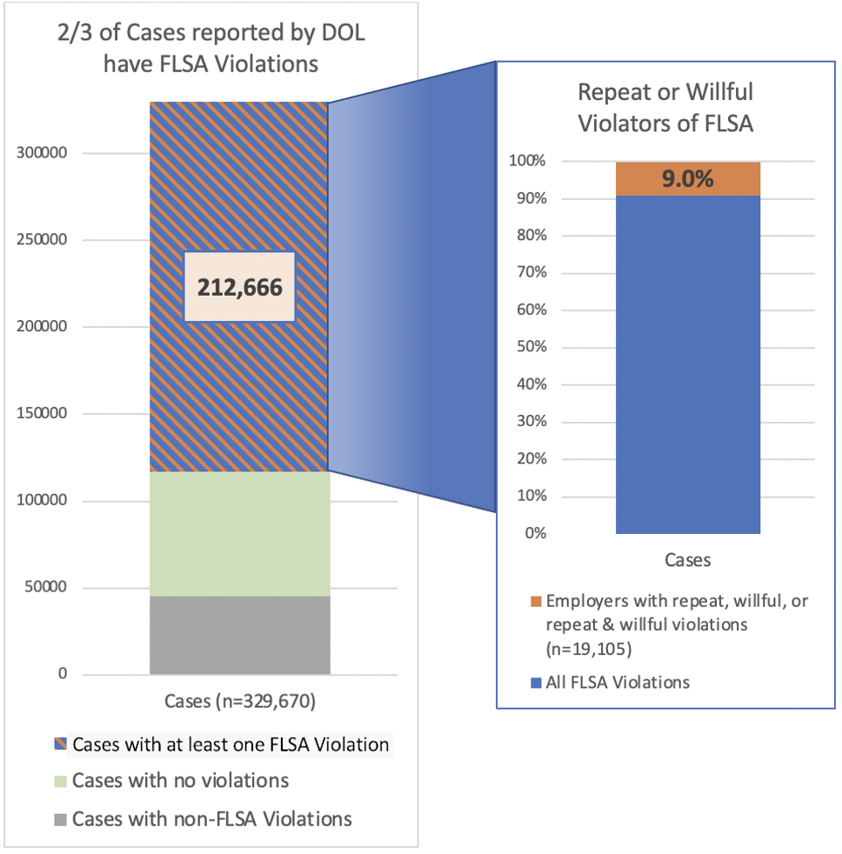
Defense Department Debarments:
Closer Look

Slide 25
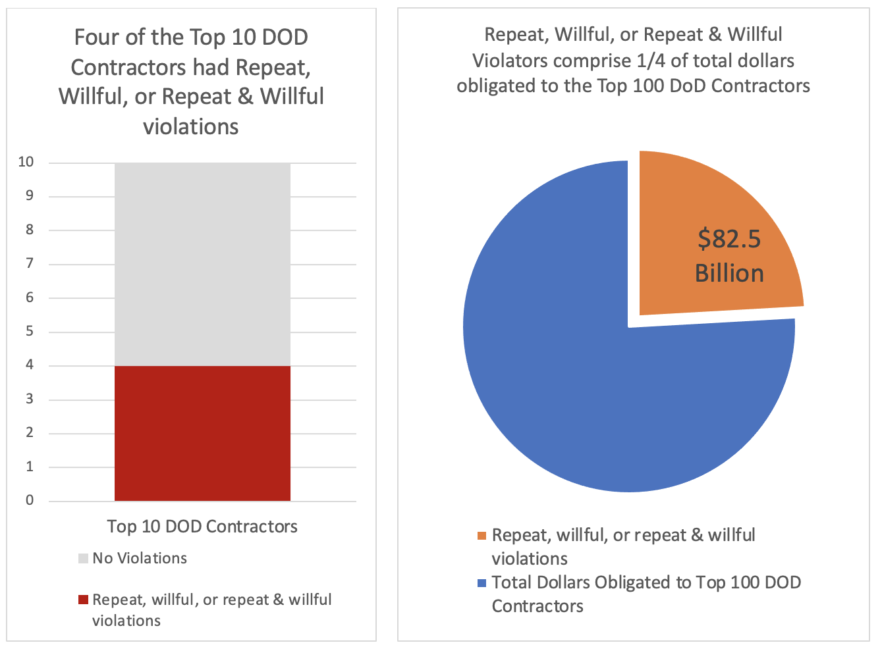
Potential Impact on DoD Industrial Base

Slide 26
Report: Possible Next Steps
Improving Transparency Regarding Debarment Actions: The federal repository of debarment information, SAM, does not provide detailed information regarding the reasons for debarment. Although FAR 9.404 says that the cause of debarment is to be listed, the explanation for a contractor’s debarment is typically given in very generic terms. It is generally impossible to determine, therefore, whether a contractor has been suspended or debarred for violations of labor laws. This makes debarment a less effective deterrent, for it means that other governments or parties which might look to this debarment information, not knowing the basis for debarment, will be less likely to rely on the mere listing of a debarred contractor.
Improving Procurement Officials’ Access to and Understanding of Information Regarding Labor Law Violations: Although DOL publishes extensive data regarding alleged violations of labor law in its publicly available Data Enforcement databases, procurement officials we spoke with generally did not know how to access or use that data. DOL does not assign or use unique identifiers for contractors that would allow for ready identification, and contracting officers and debarring officials are seldom, if ever, trained in finding or assessing data regarding labor violations.
Transferring Data Regarding Labor Law Violations to SAM: To simplify procuring officials’ access to labor law violations, another option would be to share information between DOL and SAM (which a contracting officer must review before making a responsibility finding prior award). Simply making the enormous trove of DOL data regarding alleged labor law violations available in SAM would not, however, necessarily be helpful to a Contracting Officer without an explanation and context for the labor law violations. SDOs are even more likely to use that data in a meaningful manner because their processes allow for investigation and review, typically focused on a specific contractor and assessing the contractor’s compliance systems over a span of time to determine present responsibility.
Requiring Contractors to Disclose Labor Law Violations in SAM: Another approach would be to require contractors to submit data regarding finally adjudicated labor law violations as part of their regular representations and certifications into SAM. While prospective contractors are currently required to disclose whether they are suspended or debarred, they are not required to disclose labor law violations. Issues regarding requiring contractor disclosure of labor law violations are discussed further below.
Requiring Contractor Disclosure of Labor Law Violations to the Contracting Agency: Another approach would be to require contractors to disclose labor law violations directly to contracting agencies. This was a cornerstone to the Obama administration’s “Fair Pay and Safe Workplaces” executive order, which would have required contractor disclosures of labor law compliance in an effort to enhance governmentwide compliance. That executive order was repealed by President Trump , and Congress passed a joint resolution of disapproval of the implementing rule. The resolution was signed by President Trump and became Public Law 115-11. Under the Congressional Review Act, a new rule “that is substantially the same as” the rule disapproved by Congress “may not be issued, unless the . . . new rule is specifically authorized by a law enacted after the date of the joint resolution disapproving the original rule.”

Slide 27
Audience Questions
How an exclusion on one business entity affects the responsibility determination of a related business (e.g. parent, subsidiary, same majority owner but different business, etc.)?
What is the most common type of violation and is there a way we can write contracts to call this out specifically?
How can we tie the information in these records to DCAA audit performance?
Are lead agency coordination requests sent to the ISDC for statutory DOL exclusions?

Slide 28
Conclusion – see you October 4!
Registration: https://www.dau.edu/event/Assessing-Contractor-Labor-Law-Violations-Responsibility-and-Debarment-Part-2-4-Oct-2023
David.A.Drabkin@gmail.com
cyukins@law.gwu.edu

