Slide 1
A Comparison of US-EU Procurement systems
Dan schoeni
Los angeles, California
The views expressed are the author’s and do not reflect an official position of the Department of the Air Force, the DoD, or any other U.S. government agency.

Slide 2
Elevator Pitch
Transatlantic trade matters. Combined US/EU economy is nearly half of global GDP.
Public procurement composes 15-20% of most economies.
Despite huge private trade, transatlantic public procurement trade is modest.
Tariffs aren’t the problem. Non-tariff barriers are.
Arie Reich: calls these “invisible” procedural obstacles.
Hypothetical: suppose had TTIP passed and all of the overt barriers were removed. What barriers would remain?
From the perspective of a contractor experienced with public procurement on one side of the Atlantic, what would she miss?

Slide 3
Introduction
Comparing these two systems is really hard. Let me explain how I did it.

Slide 4
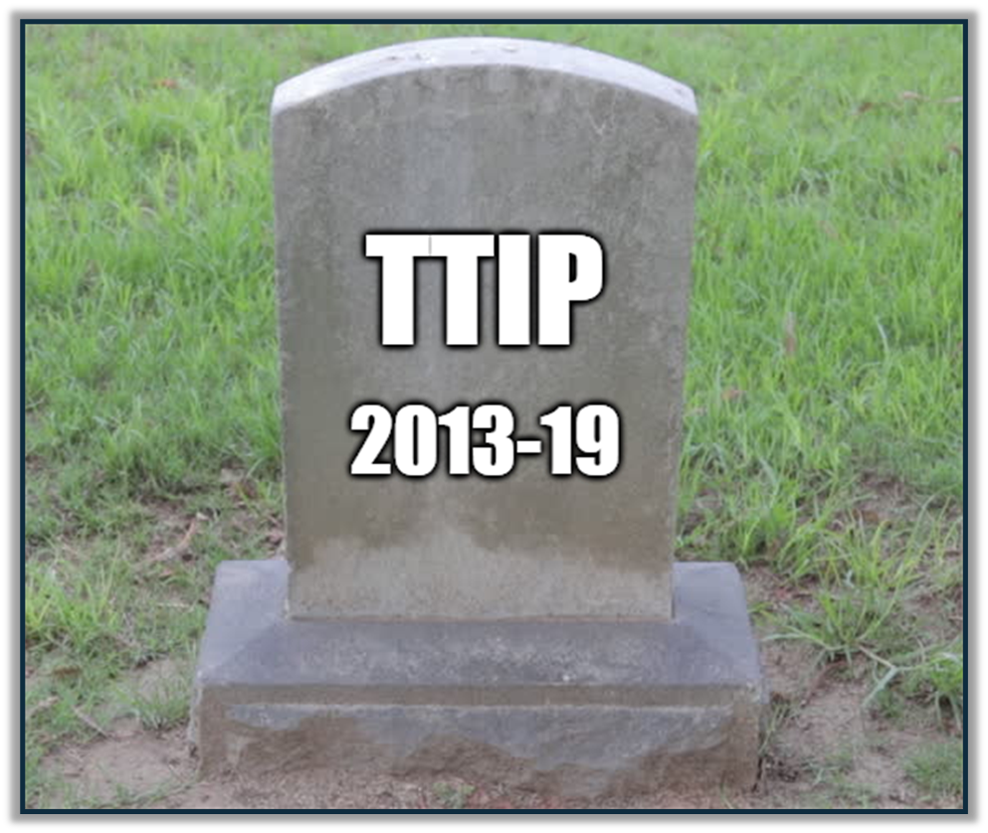
“TTIP” hypothetical: imagine Overt barriers were removed
United States
European Union
Made in America EO (Biden)
Buy American Act
Balance of Payments Program
Berry Amendment
Utilities Directive, Article 84(3): favor local if foreign share exceeds 50%
International Procurement Instrument (threat of)

Slide 5
Subtle non-tariff barriers not assumed away
Sue Arrowsmith: “structural restrictions”
Yukins & Schooner: “alien procurement regimes” create “practical barriers”
Such hidden barriers may result from:
simple divergence of laws, regulations & procedures
embedded legal culture
Arwel Davies: mere divergences in procurement laws can have a chilling effect on trade.
Me: our legal culture shapes how we understand foreign legal systems, and this can also discourage participation.

Slide 6
A Transatlantic thought experiment
How would each system look from the perspective of a transatlantic supplier?

Slide 7
taxonomy of “embedded legal culture”
Three categories of “law” that are resistant to change.
Constitutional character
Written constitutions, institutional structure
Legal traditions
Web of precedent, informal norms, and canons of interpretation
Policy objectives
Desiderata or goals, usually set forth in statute or regulations

Slide 8
Innocents abroad
How would an American supplier familiar with the U.S. federal system (mis)understand the EU’s system?
How would that affect participation?
How would a European supplier familiar with the EU procurement directives (mis)understand the US federal procurement system?
How would that affect participation?
Touchstone:
How would a transatlantic supplier understand this rule?

Slide 9
The level of comparison chosen
United States
European Union
Federal
State
Local
EU (financial regulations)
Member State (directives)
Regional
Local
Hanna Schebesta: a “unified” European outlook

Slide 10
Recurring themes
Some themes kept reappearing in later chapters. I moved them here.

Slide 11
Enlightenment or Post-war origin?
The United States is a younger nation than most of our European cousins, its procurement system is (at least in one sense) older.
The foundations of the U.S. were laid during the Revolutionary War (1775–83), whereas EU’s common procurement system originated post WW II.
This has several ramifications. For example:
(1) EU’s qualification and award procedures are relatively unsettled.
(2) Competition new to much of Europe (1981).

Slide 12
Domestic or supranational?
One is system and the other supranational (or quasi-international).
Domestic systems tend to focus on best value, supranational on access.
This distinction affects how qualification and award procedures are prioritized:
(1) because the United States prizes best value for money, that is considered first (award procedures)
(2) because the European Union prizes non-discrimination, consideration of the suppliers’ qualifications comes first

Slide 13
Taxpayer or supplier oriented?
Last section was about what each system served (best value/non-discrimination), this section is about whom each serves.
The U.S. system is oriented toward the taxpayer (price) or end-user (best value).
The EU concentrates on non-discrimination or fairness to the economic operator.
This explains the multifaceted aims of the U.S. system, which serves the ephemeral wants of the voters,
and the more unitary aim of the EU’s system, which serves the supplier who wants (mainly) access.

Slide 14
Composition of purchases: civil or defense?
What a system regulates affects how it works.
Since 1789, the U.S. priority has been to “provide for the common defence,” and nearly 80% of federal procurement spending goes to defense.
Although the EU spends a comparable amount on defense, the directives cover all levels of government so the proportion spent on defense is lower (.3%).
U.S. system is geared toward purchasing sophisticated weapons, whereas the EU procurement directives concentrate on buying standard commercial products.

Slide 15
Three procedures
Qualification & Award, (2) competitive procedures,
and (3) challenge procedures

Slide 16
Qualification & Award
Previously, there had been a wide gap as to the consideration of suppliers’ experience and qualifications; previously strictly prohibited in the EU.
But under the 2014 Directive, experience and qualifications can now be considered (at least in under some circumstances), much like America.
Yet when the two systems’ rules become similar enough, it becomes easier to miss subtle but relevant differences.
Thus, even with more similar rules, small differences may deter participation.

Slide 17
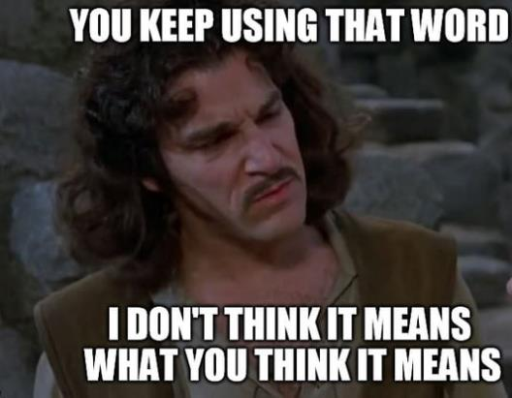
competitive procedures
Each fears a different “dragon”: Americans distrust public officials; Europeans fear tribalism (favoritism).
Different ideas of “competition”, and this manifests in a couple of ways:
Europeans: disfavor negotiation
U.S.: willing to limit competition

Slide 18
challenge procedures
Americans pride themselves in having a culture of litigation, and that extends to public procurement.
Protests are new in most of the EU, and yet use has far surpassed that of the United States
Data are scarce at the state and local level, but my research confirms state level is also much lower.

Slide 19
Average protests per million
United States (2016-20): 6.6
Federal 3
States (31): 3.6
GPA (25): 3.5
Non-GPA (6): 4.3
Local: unknown
European Union (2008-12): 27
France: 0.1
Spain: 6.9
Germany: 12.5
Poland: 69.7
Sweden: 272.6
Even if we assume another 3 per million for local bid protests . . . Sweden’s litigation is 27 times that of that in the United States.

Slide 20
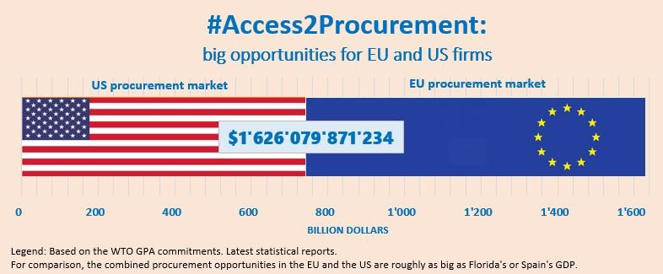
conclusion
Nothing startling . . . to anyone who’s thought much about both systems.

