Slide 1
A wave of SPP rules: SPP requirements beyond the PP directives?
Vienna, 3° October 2024
Roberto CARANTA
This project has received funding from the European Union’s Horizon 2020 research and innovation
programme under the Marie Skłodowska-Curie grant agreement No 956696.

Slide 2
The legislative framework
Some constraints in the EU rules to promote GPP
requirement for linked to the subject matter of the contract
objectivity/measurables
Mandatory GPP as technical specifications, award criteria and/or exclusion/selection
Whether targets and mandatory procurement rules are a way forward
This project has received funding from the European Union’s Horizon 2020 research and innovation
programme under the Marie Skłodowska-Curie grant agreement No 956696.

Slide 3
Introduction

Slide 4
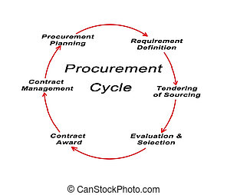
This project has received funding from the European Union’s Horizon 2020 research and innovation
programme under the Marie Skłodowska-Curie grant agreement No 956696.
EU Law Focus(ed)
On How to Buy
Market opening instruments
Coverage
Tech specs/contract performance clauses
Selection of the contractor/exclusion criteria
Award procedures

Slide 5
This project has received funding from the European Union’s Horizon 2020 research and innovation
programme under the Marie Skłodowska-Curie grant agreement No 956696.
2014/Directives
A general principle
Exclusions/labels
Contract design/tech specs/CPC
Award: LCC and abnormally low
L2SM and life cycle
empowering SPP (with hinderances) rather than mandating SPP

Slide 6
This project has received funding from the European Union’s Horizon 2020 research and innovation
programme under the Marie Skłodowska-Curie grant agreement No 956696.
A Cardinal Value
C-395/18 – Tim
by providing that EOs must comply, in the performance of the contract, with obligations relating to environmental, social and labour law, the Union legislature sought to establish that requirement as a principle, like the other principles referred to in paragraph 1 of that article, namely the principles of equal treatment, non-discrimination, transparency, proportionality and prohibiting the exclusion of a contract from the scope of Directive 2014/24 or artificially narrowing competition.
It follows that such a requirement constitutes, in the general scheme of that directive, a cardinal value with which the Member States must ensure compliance pursuant to the wording of Article 18(2) of that directive

Slide 7
Some constraints in the EU rules to promote GPP

Slide 8
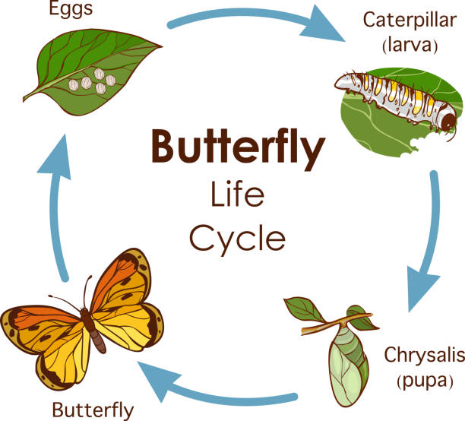
This project has received funding from the European Union’s Horizon 2020 research and innovation
programme under the Marie Skłodowska-Curie grant agreement No 956696.
L2SM
3. Award criteria shall be considered to be linked to the subject-matter of the public contract where they relate to the works, supplies or services to be provided under that contract in any respect and at any stage of their life cycle, including factors involved in:
(a) the specific process of production, provision or trading of those works, supplies or services; or
(b) a specific process for another stage of their life cycle,
even where such factors do not form part of their material substance.
However, the condition of a link with the subject-matter of the contract excludes criteria and conditions relating to general corporate policy, which cannot be considered as a factor characterising the specific process of production or provision of the purchased works, supplies or services. Contracting authorities should hence not be allowed to require tenderers to have a certain corporate social or environmental responsibility policy in place.

Slide 9
This project has received funding from the European Union’s Horizon 2020 research and innovation
programme under the Marie Skłodowska-Curie grant agreement No 956696.
HOWEVER
Recital 97 (last phrase) the condition of a link with the subject-matter of the contract excludes criteria and conditions relating to general corporate policy, which cannot be considered as a factor characterising the specific process of production or provision of the purchased works, supplies or services. Contracting authorities should hence not be allowed to require tenderers to have a certain corporate social or environmental responsibility policy in place.
HOWEVER CSDDD (Directive (EU) 2024/1760)

Slide 10
This project has received funding from the European Union’s Horizon 2020 research and innovation
programme under the Marie Skłodowska-Curie grant agreement No 956696.
OBJECTIVITY
Eg:
the label requirements are based on objectively verifiable and non-discriminatory criteria (Art. 43)
Award criteria shall not have the effect of conferring an unrestricted freedom of choice on the contracting authority. They shall ensure the possibility of effective competition and shall be accompanied by specifications that allow the information provided by the tenderers to be effectively verified in order to assess how well the tenders meet the award criteria. (Art. 67(4))
method used for the assessment of costs imputed to environmental externalities shall be based on objectively verifiable and non-discriminatory criteria. In particular, where it has not been established for repeated or continuous application, it shall not unduly favour or disadvantage certain economic operators (Art. 68(2)(a))

Slide 11
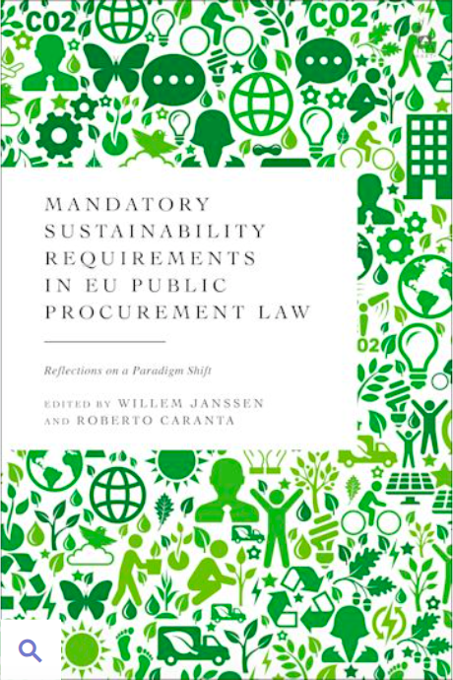
Mandatory GPP as technical specifications, award criteria and/or exclusion/selection

Slide 12
This project has received funding from the European Union’s Horizon 2020 research and innovation
programme under the Marie Skłodowska-Curie grant agreement No 956696.
PP & EUROPEAN GREEN DEAL
The Green Deal: “Public authorities, including the EU institutions, should lead by example and ensure their procurement is green”.
The European Green Deal Investment Plan “The Commission will propose minimum mandatory green criteria or targets for public procurements in sectoral initiatives, EU funding or product-specific legislation”.
https://ec.europa.eu/commission/presscorner/detail/en/fs_20_48

Slide 13
This project has received funding from the European Union’s Horizon 2020 research and innovation
programme under the Marie Skłodowska-Curie grant agreement No 956696.
Batteries Regulation
Regulation (EU) 2023/1542 concerning batteries and waste batteries
Art. 85(1) CA/Es shall “take account of the environmental impacts of those batteries over their life cycle with a view to ensuring that such impacts are kept to a minimum”.
Art. 85(3) Commission establishes award criteria for procurement procedures for batteries, or products containing batteries, based on the sustainability requirements. CA/Es shall refer to those criteria

Slide 14
This project has received funding from the European Union’s Horizon 2020 research and innovation
programme under the Marie Skłodowska-Curie grant agreement No 956696.
NZIA: Regulation (EU) 2024/1735
incentivising the purchase of net-zero technology products
environmental sustainability contribution will be a mandatory minimum requirement
resilience contribution will be applied if there is a third-country dependence of more than 50% for a specific strategic net-zero technology (or for its components) (only be considered if the Commission has first assessed the level of dependence of each technology from a particular third country)
If the application of the resilience and sustainability contribution results in a disproportionate cost difference or if no suitable tenders or requests have been submitted, contracting authorities may decide to not apply these criteria

Slide 15
2024 CSDDD
MSs
shall ensure that CAs and entities may exclude economic operators for non-compliance,
may require compliance with the national rules implementing the Directive as contract performance conditions for those economic operators bound by it.
Similarly, compliance with those rules by economic operators not bound by them may be valorised as an award criterion
This project has received funding from the European Union’s Horizon 2020 research and innovation
programme under the Marie Skłodowska-Curie grant agreement No 956696.

Slide 16
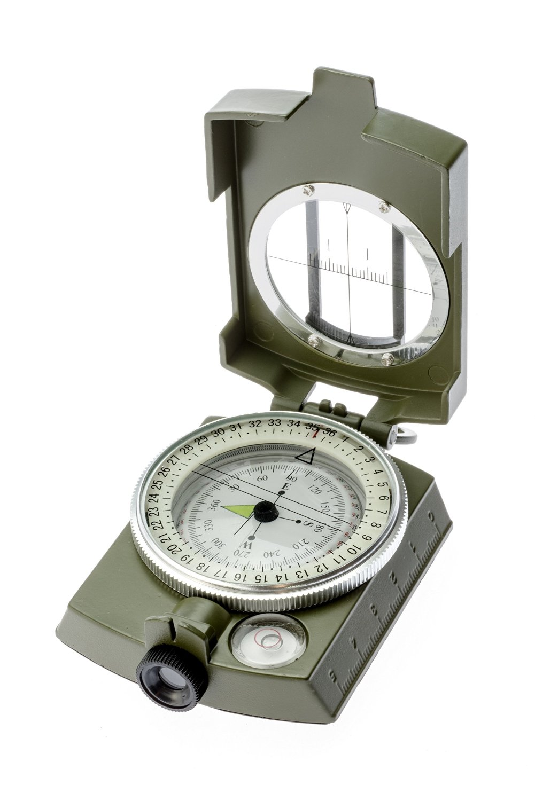
Whether targets and mandatory procurement rules are a way forward

Slide 17
This project has received funding from the European Union’s Horizon 2020 research and innovation
programme under the Marie Skłodowska-Curie grant agreement No 956696.
Clean Vehicles
NEW Directive 2019/11/61 on clean vehicles
Minimum MS specific targets
reporting and review clause
MSs have to meet at least half of the procurement target for clean buses through the procurement of zero-emission buses

Slide 18
This project has received funding from the European Union’s Horizon 2020 research and innovation
programme under the Marie Skłodowska-Curie grant agreement No 956696.
Approaches
Exclusions: info?
Targets: controls!
SPP criteria: takes time!
Any alternative?

Slide 19
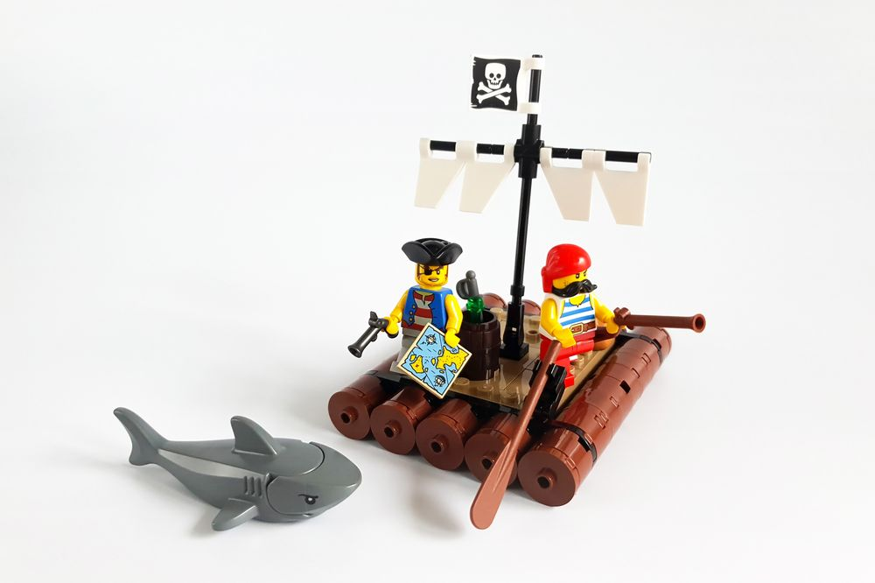
It is outside the PP directives …
How do you know???

Slide 20
THANK YOU
This project has received funding from the European Union’s Horizon 2020 research and innovation
programme under the Marie Skłodowska-Curie grant agreement No 956696.

