Slide 1
Procurement as Risk Management:
AIRC Debarment and Bid Protest Studies
International Public Procurement Conference 2024
Umm Al Quwain, UAE - October 3, 2024
David Drabkin and Christopher Yukins (George Washington University Law School)
Co-Principal Investigators
D

Slide 2
Introductions –
  David Drabkin, drabkind@gmail.com
  Christopher Yukins, cyukins@law.gwu.edu
Study: Mandatory Debarments for U.S. Labor Violations
Study: Department of Defense Bid Protests
Common theme: Risk management in procurement
Questions and Conclusion
C

Slide 3

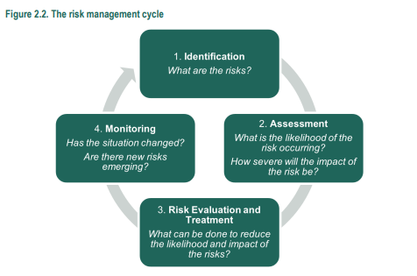
C

Slide 4
AIRC Debarment Study
D

Slide 5
US Federal Debarment Process
Each Federal Agency with independent procurement authority has a Suspension/Debarment Official (SDO).
SDO’s may initiate a suspension or debarment action “sua sponte” based on information that comes to her/his attention
Normally, suspension/debarment actions are initiated based on referral from contracting officers, Inspector General’s, or criminal investigative organization
  Most SDOs do not have their own investigators
Initiation of a Suspension/Debarment proceeding other than a “Show Cause,” results in the placement of the contractor/individual on the Excluded Parties List (EPLS) now incorporated at www.sam.gov
Contracting officers and grant officers are required to check the System for Award Management (SAM.gov) to determine whether a potential awardee is currently debarred or suspended
An award can be made to a party on the list under certain circumstances requiring approval at the highest levels in the agency.
D

Slide 6
US Federal Debarment Process
Placement on the “list” means no contracts may be awarded to the party.
For proposed debarments the length of time lasts until the proposal is resolved.
Where a decision to suspend or debar is final the exclusion from government contracting lasts for the period of time indicated in the decision
Note: Many State and Local government use the federal government list, federal prime and subcontractors must use the list, financial institutions and nonprofits choose to use the list
Contractors/individuals proposed for suspension/debarment have the right to respond to the proposal of debarment
Parties are afforded “Administrative Due Process” - notice and an opportunity to be heard.
The normal process is conducted on “paper”
On occasion contractors/individuals may meet with the SDO to present matters for consideration
Decisions to suspend/debar a contractor/individual are made in writing and delivered to the party.
Parties may be suspended/debarred for an appropriate period of time, normally 3 years.
The object of the exercise is to ensure that the party makes the appropriate efforts to become “responsible”
Parties may seek review of a suspension/debarment in a Federal District Court under the Administrative Procedures Act -- rare
D

Slide 7
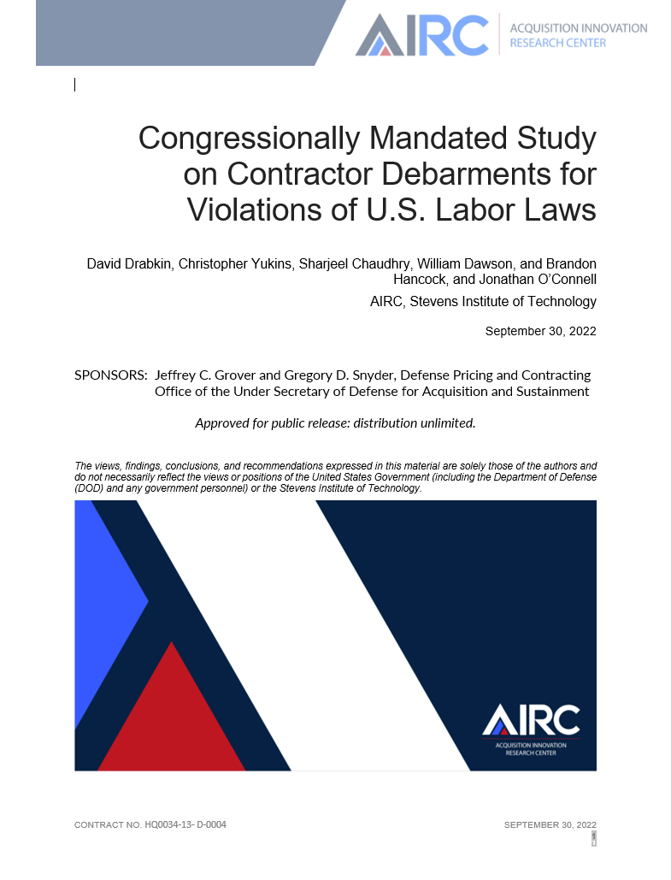
Question for report:
Should certain U.S. labor law violations be an automatic basis for debarment?
D

Slide 8
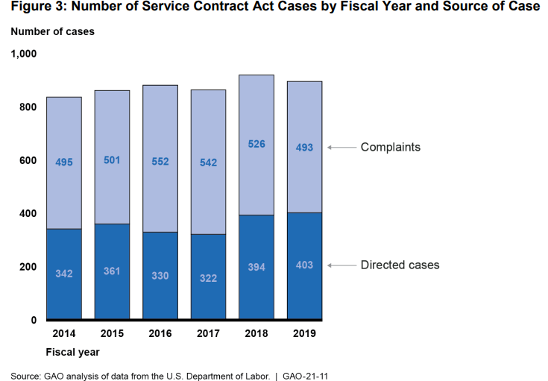
Statutory (“Mandatory”) Debarments –
Labor Violations
In practice, the Labor Department does not impose statutory debarment upon federal contractors in the vast majority of cases of non-compliance with statutes that mandate debarment.
D

Slide 9
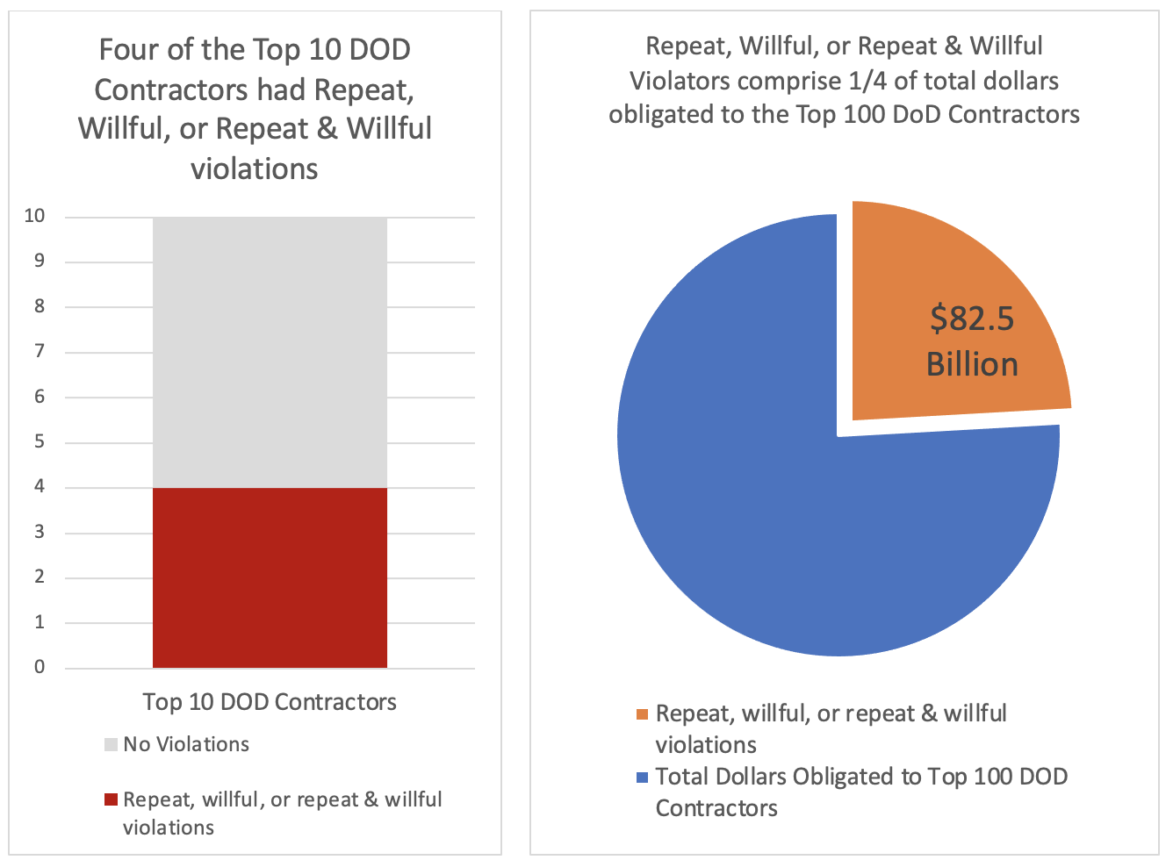
Potential Impact of Mandatory Debarment for FLSA Labor Violations on DoD Industrial Base
C

Slide 10
AIRC Bid Protest Study
D

Slide 11

Background Question: Do Bid Protests Serve Two Roles?
Assure bidders of fair competition
Management tool

Slide 12
What Are Agency-Level Protests – And Why Are They Important to Management?
Agency-Level Protests
Decision by contracting official(s)
GAO
100-day protest timeline
Court of Federal Claims
Indefinite timeline
Rapid
Agency-run
Extensive administrative record
Potential appeal
Relevant agency record
Agency legal and factual submissions
Federal court proceeding
C

Slide 13
Recommendations: Strengthen Agency-Level Bid Protests by Using Best Practices Evolved Across Government
1. Formalize the role of an “Agency Protest Official” to oversee agency-level protest procedures at the agencies.
2. Confirm that agencies have broad authority to hear agency-level protests, so that agencies have the flexibility to address new problems in novel procurement methods, such as procurements using other transaction authority.
3. Leave the standard for standing flexibly bound to that used by GAO and the courts, to allow agency-level protests to evolve with other protest fora to accommodate new kinds of “whistleblowers” (protesters) in the acquisition system.
4. Clarify the decision-making process in agency-level protests, perhaps by reshaping it to more closely resemble the tiered decision-making called for by the Contract Disputes Act for contract administration claims.
5. Specify the record necessary for agency-level bid protests, to ensure that the issues raised can be fully addressed on the administrative record.
6. Maximize the record shared with agency-level protesters to encourage rapid resolution of issues.
7. Rationalize the stay of performance in the event of an agency-level protest, so that the protester remains confident that the protester’s key goal–having an opportunity to recompete fairly for the contract–is not lost to delay.
8. Publish data on agency-level protests, including, potentially, the decisions themselves to reinforce regularity and confidence in the acquisition system.
C

Slide 14
David Drabkin: drabkind@gmail.com
Christopher Yukins: cyukins@law.gwu.edu
D

