Slide 1
The Supreme Court’s Decision in Snyder v. United States (2024) – Implications for the Model Procurement Code
Christopher Yukins
George Washington University Law School
November 2024

Slide 2
D
Gratuity means a payment, loan, subscription, advance, deposit of money, services, or anything of more than nominal value, present or promised, unless consideration of substantially equal or greater value is received.
ABA Model Procurement Code (2000)

Slide 3
Gratuities. It shall be a breach of ethical standards for any person to offer, give, or agree to give any employee or former employee, or for any employee or former employee to solicit, demand, accept, or agree to accept from another person, a gratuity or an offer of employment in connection with any decision, approval, disapproval, recommendation, preparation of any part of a program requirement or a purchase request, influencing the content of any specification or procurement standard, rendering of advice, investigation, auditing, or in any other advisory capacity in any proceeding or application, request for ruling, determination, claim or controversy, or other particular matter, pertaining to any program requirement or a contract or subcontract, or to any solicitation or proposal therefor.
Model Procurement Code Sec. 12-206
Gratuity means a payment, loan, subscription, advance, deposit of money, services, or anything of more than nominal value, present or promised, unless consideration of substantially equal or greater value is received.

Slide 4
Snyder v. United States (Supreme Court 2024) - Facts
This case involves James Snyder, who is the former mayor of Portage, Indiana. In 2013, while Snyder was mayor, Portage awarded two contracts to a local truck company, Great Lakes Peterbilt, and ultimately purchased five trash trucks from the company for about $1.1 million. In 2014, Peterbilt cut a $13,000 check to Snyder. The FBI and federal prosecutors suspected that the payment was a gratuity for the City’s trash truck contracts. But Snyder said that the payment was for his consulting services as a contractor for Peterbilt. A federal jury ultimately convicted Snyder of accepting an illegal gratuity in violation of §666(a)(1)(B). The District Court sentenced Snyder to 1 year and 9 months in prison. On appeal, Snyder argued that §666 criminalizes only bribes, not gratuities. The Seventh Circuit affirmed Snyder’s conviction

Slide 5
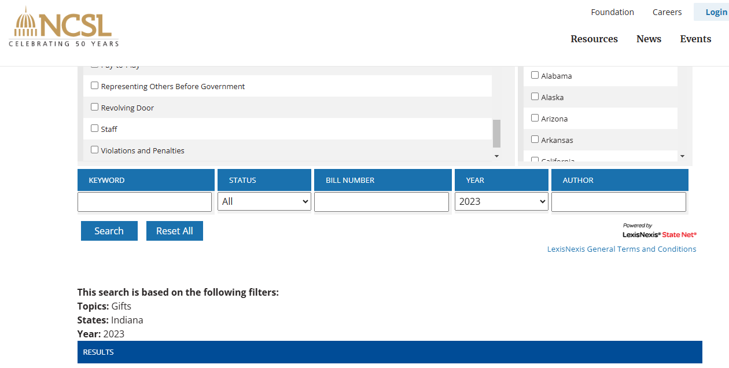
Snyder – Facts (cont’d)

Slide 6
Snyder – Facts From Government Brief Before the Supreme Court
Red Flags
Around the time that petitioner assumed office, Portage needed to buy new garbage trucks. Pet. App. 27a. Although the city purported to conduct a fair public bidding process, “there were significant irregularities in the bidding process” indicating that petitioner “had it set up to come out in * * * favor” of Great Lakes Peterbilt (GLPB), a trucking company owned by two brothers, Robert and Stephen Buha, who were “in serious financial difficulty” of their own. Id. at 56a-57a. At the outset, petitioner “hand-picked” his “close friend” Randy Reeder to administer the bidding process, even though Reeder had “no experience” with administering public bids. Pet. App. 27a, 57a. And when petitioner did so, he told a “longtime veteran” of the city’s Streets and Sanitation Department, who had “extensive experience overseeing public bid processes[,] * * * not to get involved in the bid processes and that he and Reeder would handle it.” Id. at 57a.
Reeder then “tailored the bid specifications to favor GLPB.” Pet. App. 27a. Among other things, Reeder “based the chassis specifications on a Peterbilt chassis,” the precise type that GLPB sold, and “specified that the trucks must be delivered within 150 days, a deadline that was suggested to him by GLPB, but was an unusually fast turnaround for a new garbage truck.” Ibid. Petitioner knew that GLPB “could meet 150 days and the other companies could not.” 3/16/21 Tr. 1457. Portage could have saved about $60,000 by not demanding such expedited delivery. 3/11/21 Tr. 679, 690; 3/16/21 Tr. 1431.
Reeder also directed that bids be submitted to petitioner, rather than the city clerk-treasurer, and he “turned down equipment demonstrations offered by a number of [other] prospective suppliers.” Pet. App. 58a; see id. at 57a. Both of those practices were unusual or unprecedented. See 3/10/21 Tr. 494; 3/12/21 Tr. 893, 945- 946. GLPB was the only bidder whose bid was able to satisfy all of the requirements that Reeder had imposed, 3/16/21 Tr. 1431-1432, and a board consisting of petitioner and two of his appointees voted to award the contract to GLPB. Pet. App. 27a-28a.
Later in his term, petitioner attempted to have the city buy “an unused, 2012 model truck that had been sitting on GLPB’s lot for two years,” exposed to the elements. Pet. App. 28a; see 3/18/21 Tr. 1992. The Buhas had been unable to sell the truck and soon “would have had to start making balloon payments on [a] loan in order to avoid losing [it].” Pet. App. 59a. After a city lawyer advised “that the truck was too expensive to be purchased without going through the public bidding process,” Portage opened a new round of bidding for two additional trucks in November 2013. Id. at 28a. Reeder “adjusted th[e] specifications” for bidding on one of the trucks “to match the truck sitting on GLPB’s lot,” notwithstanding that the truck was not the current model (a fact that petitioner and Reeder never disclosed to the other contracting-board members) and that, “from a maintenance standpoint, it made little sense to purchase trucks with different specifications.” Pet. App. 28a. During the contracting process, petitioner personally exchanged dozens of phone calls and text messages with the Buhas—but none with any other bidders. Id. at 29a, 60a. GLPB again won the contract, id. at 28a; the total value of the two contracts awarded to GLPB was $1.125 million. Id. at 27a.
Less than three weeks after the second contract was awarded, GLPB issued a check for $13,000 to a defunct firm owned by petitioner. Pet. App. 28a-29a, 56a. Most of the funds were “quickly transferred to [petitioner’s] personal account.” Id. at 57a. Petitioner offered various conflicting explanations for the payment, telling a city planning consultant that GLPB paid him “to lobby the state legislature on its behalf ”; telling Reeder that the money was for “phone and payroll consulting” for GLPB; and later telling the FBI that it was for “health insurance and information technology consulting.” Id. at 29a; see 3/16/21 Tr. 1489. But neither petitioner nor the Buhas produced any “documentation relating to any consulting agreement or services performed by [petitioner] for GLPB,” and petitioner did not include the $13,000 payment on a form to disclose compensation he received from parties doing business with the city. Pet. App. 61a; see id. at 30a, 44a; J.A. 65, 67-76. And at the time GLPB’s controller issued the check, Robert Buha told the controller that “they were paying [petitioner] for his influence.” Pet. App. 29a; see id. at 60a-61a.

Slide 7
Bribes Before, Gratuities After (?)
“Bribes are typically payments made or agreed to before an official act in order to influence the public official with respect to that future official act. Gratuities are typically payments made to a public official after an official act as a reward or token of appreciation.”

Slide 8
Gifts and Gratuities – Different Approaches
“Some gratuities might be innocuous, and others may raise ethical and appearance concerns. Federal, state, and local governments have drawn different lines on which gratuities and gifts are acceptable and which are not.”

Slide 9
Text of 18 USC 666
(a) Whoever, if the circumstance described in subsection (b) of this section exists—(1) being an agent of an organization, or of a State, local, or Indian tribal government, or any agency thereof . . .
(B) corruptly solicits or demands for the benefit of any person, or accepts or agrees to accept, anything of value from any person, intending to be influenced or rewarded in connection with any business, transaction, or series of transactions of such organization, government, or agency involving any thing of value of $5,000 or more; or
(2) corruptly gives, offers, or agrees to give anything of value to any person, with intent to influence or reward an agent of an organization or of a State, local or Indian tribal government, or any agency thereof, in connection with any business, transaction, or series of transactions of such organization, government, or agency involving anything of value of $5,000 or more;
shall be fined under this title, imprisoned not more than 10 years, or both.
(b)The circumstance referred to in subsection (a) of this section is that the organization, government, or agency receives, in any one year period, benefits in excess of $10,000 under a Federal program involving a grant, contract, subsidy, loan, guarantee, insurance, or other form of Federal assistance.
(c)This section does not apply to bona fide salary, wages, fees, or other compensation paid, or expenses paid or reimbursed, in the usual course of business.

Slide 10
Snyder: Court’s Holding and Rationale
Held: Section 666 proscribes bribes to state and local officials but does not make it a crime for those officials to accept gratuities for their past acts. Pp. 7–16. Six reasons, taken together, lead the Court to conclude that §666 is a bribery statute and not a gratuities statute—text, statutory history, statutory structure, statutory punishments, federalism, and fair notice.
(1) The statutory text strongly suggests that §666—like §201(b)— is a bribery statute, not a gratuities statute. The dividing line between §201(b)’s bribery provision and §201(c)’s gratuities provision is that bribery requires an official to have a corrupt state of mind and to accept (or agree to accept) a payment intending to be influenced in an official act. Section 666 shares the defining characteristics of §201(b)’s bribery provision. By contrast, §666 bears little resemblance to §201(c), which contains no express mens rea requirement.
(2) The statutory history reinforces that result. When enacted, §666 borrowed language from §201(c), the gratuities statute for federal officials. Two years later, Congress amended §666 to model it instead on §201(b), the bribery statute. It would be strange to interpret §666, as the Government suggests, to mean the same thing now that it did before the amendment
(3) Statutory structure reinforces that §666 is a bribery statute, not a two-for-one bribery-and-gratuities statute as the Government posits. The Government identifies no other provision in the U. S. Code that prohibits bribes and gratuities in the same provision. And §201 does not do so. That is because bribery and gratuities are “two separate crimes” with “two different sets of elements.” United States v. Sun-Diamond Growers of Cal., 526 U. S. 398, 404.
(4) For federal officials, Congress has separated bribery and gratuities into two distinct provisions of §201 for good reason: The crimes receive different punishments that “reflect their relative seriousness.” Sun-Diamond, 526 U. S., at 405. For example, accepting a bribe as a federal official is punishable by up to 15 years in prison,while accepting an illegal gratuity as a federal official is punishable by up to only 2 years. If the Government were correct that §666 also covered gratuities, Congress would have inexplicably authorized punishing gratuities to state and local officials five times more severely than gratuities to federal officials—10 years for state and local officials compared to 2 years for federal officials. The Government cannot explain why Congress would have created such substantial sentencing disparities.
(5) Interpreting §666 as a gratuities statute would significantly infringe on bedrock federalism principles. Generally, States have the “prerogative to regulate the permissible scope of interactions between state officials and their constituents.” McDonnell v. United States, 579 U. S. 550, 576. The differing approaches by the state and local governments reflect policy judgments about when gifts expressing appreciation to public officials for their past acts cross the line from the innocuous to the problematic. Those carefully calibrated policy decisions would be gutted if the Court were to accept the Government’s interpretation of §666. Reading §666 to create a federal prohibition on gratuities would suddenly subject 19 million state and local officials to a new and different regulatory regime for gratuities. The Court should hesitate before concluding that Congress prohibited gratuities that state and local governments have allowed. After all, Congress does not lightly override state and local governments on such core matters of state and local governance.
(6) The Government’s interpretation of the statute would create traps for unwary state and local officials. Sun-Diamond, 526 U. S., at 411. The Government says that the statute would not cover “innocuous” or “obviously benign” gratuities, but the Government does not identify any remotely clear lines separating such a gratuity from a criminal gratuity. The Government simply opines that state and local officials may not accept wrongful gratuities. The Government’s so called guidance would leave state and local officials entirely at sea to guess about what gifts they are allowed to accept under federal law, with the threat of up to 10 years in federal prison if they happen to guess wrong. That is not how federal criminal law works. And the Court has rejected the view that it should construe a criminal statute on the assumption that the Government will use it responsibly. See McDonnell, 579 U. S., at 576. Pp. 11–14.

Slide 11
Lessons from Snyder for the Model Procurement Code
No obvious changes needed to MPC text
  Comparing to Snyder: MPC gratuity provision is procurement-focused, much as 18 USC 666 turns on federal funding
Snyder noted that Indiana has no ethics codes for its municipalities and counties; gap MPC must be ready to fill
Problem in addressing gratuities is that local norms can vary
  MPC broadly defines gratuity, then penalizes a gratuity in connection with a procurement –
  Should MPC commentary clarify that the key to a banned gratuity is a distortion of the procurement process – or is “in connection” enough?
Supreme Court assumed bribery goes before, gratuities after, bad official act; that is an oversimplification, not for MPC
Justice Department brief highlighted usefulness of “red flags” in identifying corruption
Court’s statutory analysis foreshadows future Loper Bright-based decisions – but that’s not for MPC

Slide 12
Conclusion

